Slide 1
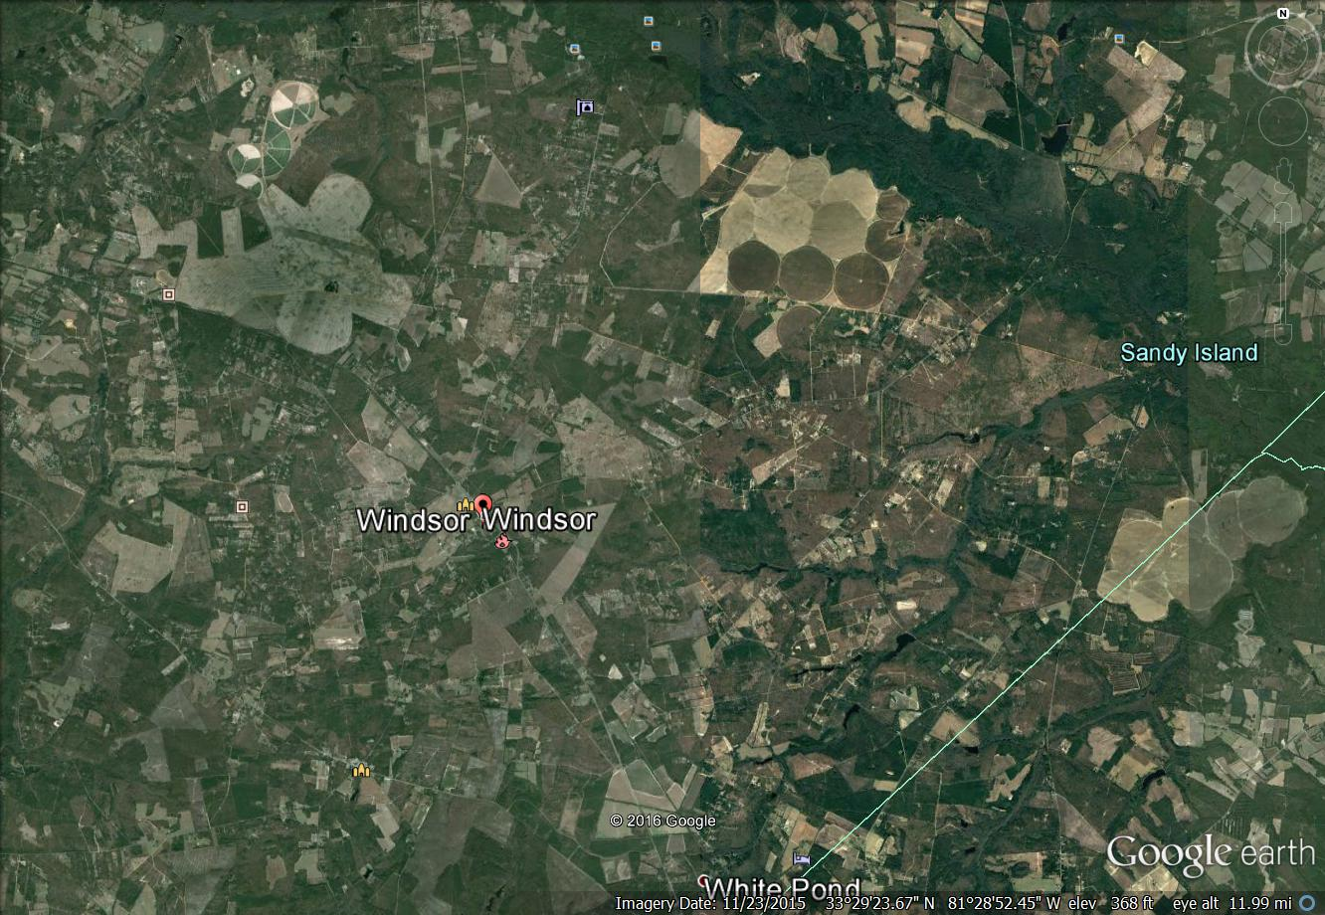
Windsor Area
Aiken St Park Wells
Walther
Windsor School well
Woody Well @
400 Feet
Montmorenci Utility
Well @ 400 Feet
Walther
Aik & Brn
Woody
Woody
Problem Well Locations
1 mile +/-
Pastoral Advocates for Aiken – DHEC 2/9/17

Slide 2
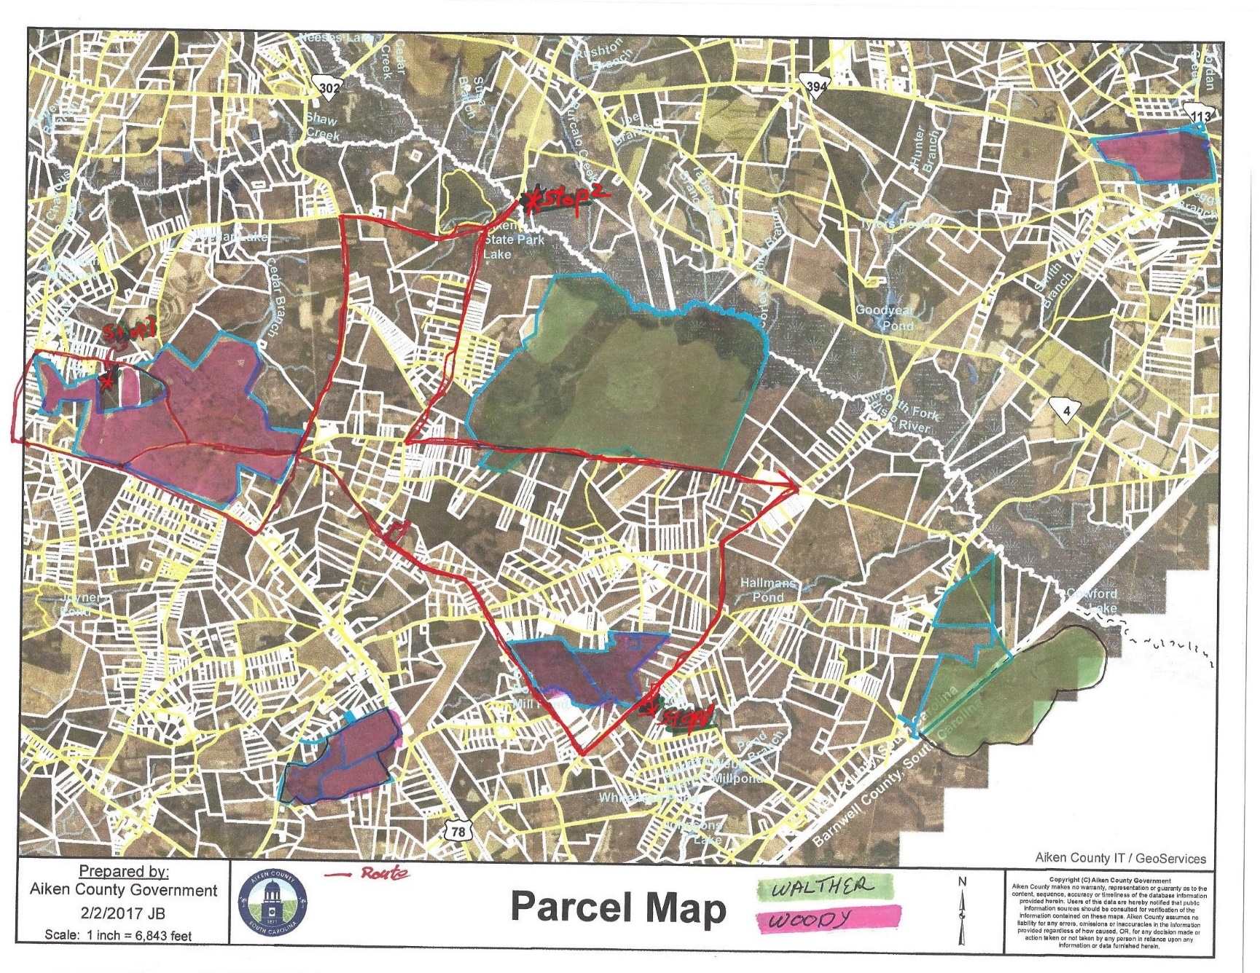
Windsor Area Tour Route
Pastoral Advocates For Aiken – DHEC 2/09/17

Slide 3
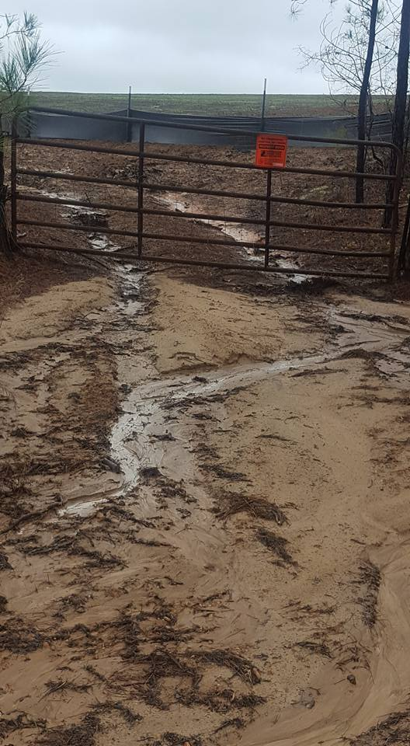
Polluted Storm Water Runoff
Pastoral Advocates For Aiken – DHEC 2/09/17

Slide 4
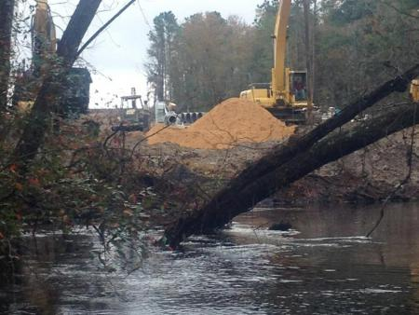
South Fork Edisto River - Safe Yield Get Photo of Doug Standing in the River
Pastoral Advocates For Aiken – DHEC 2/09/17

Slide 5
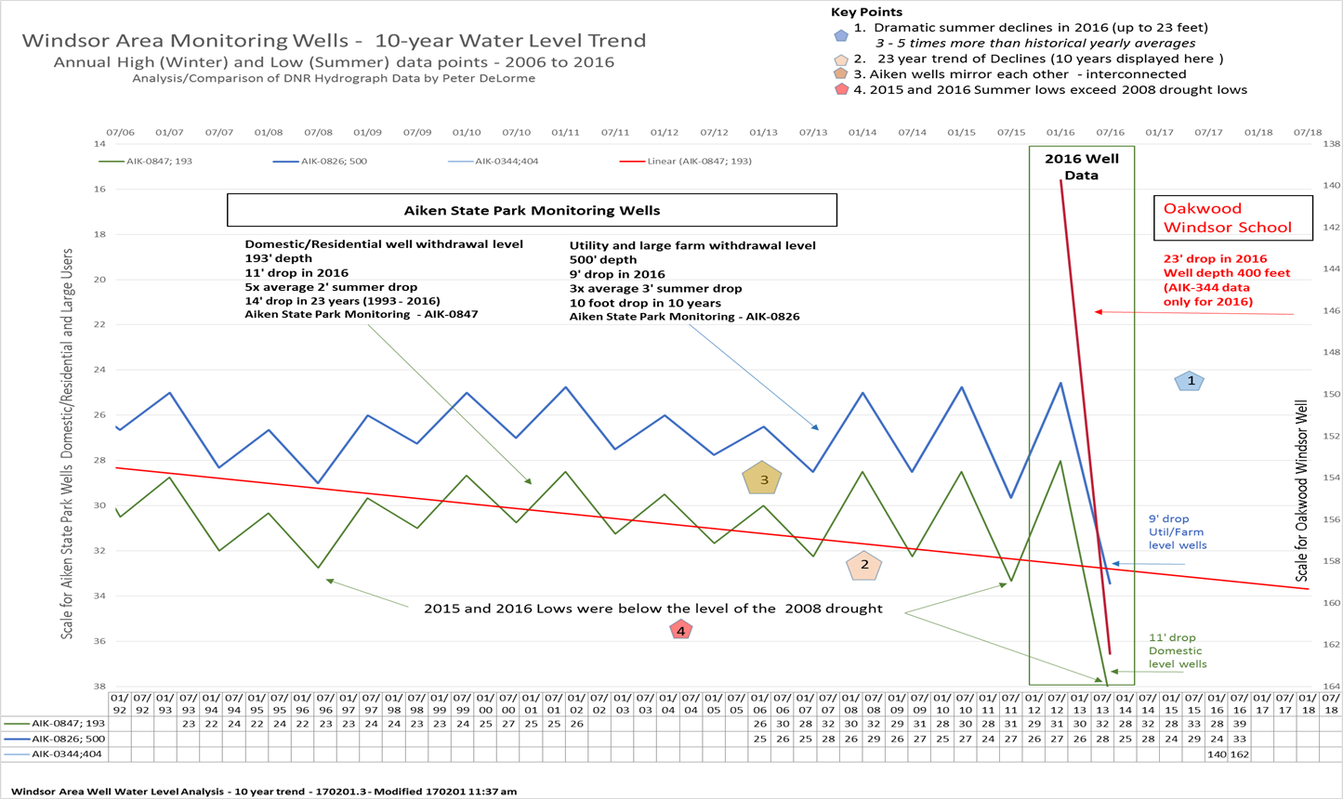
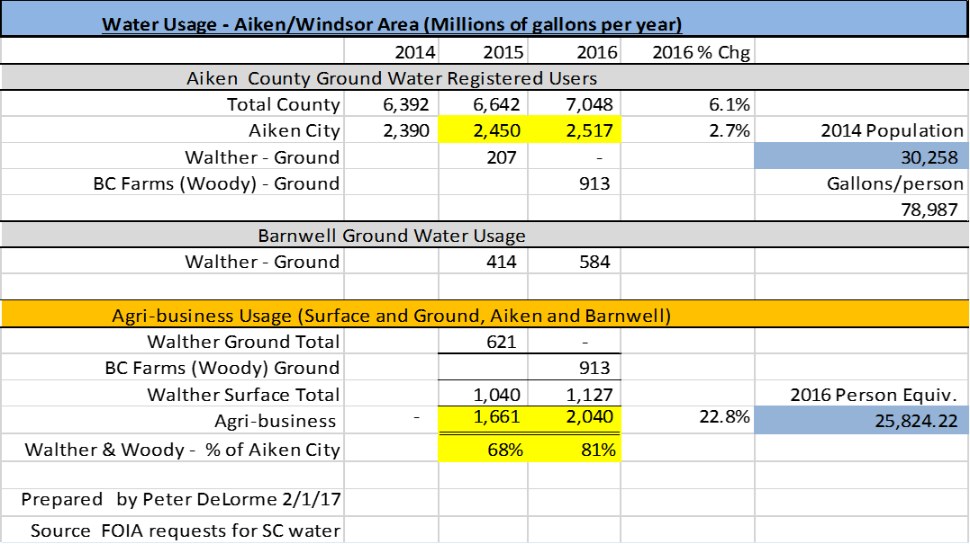
Capacity Use Designation
Pastoral Advocates For Aiken – DHEC 2/09/17

Slide 6
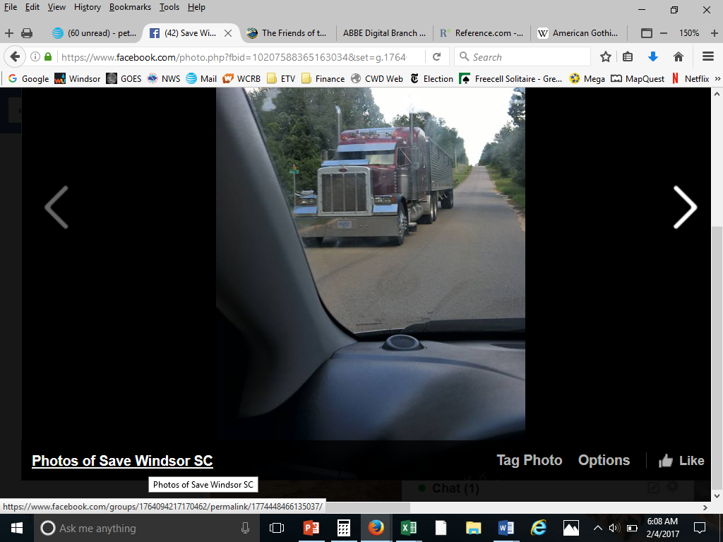
Mega-Farm Environmental Impacts
Pastoral Advocates For Aiken – DHEC 2/09/17

Slide 7

Recap, Discussion, Next Steps
Family Farm?
Family Farm Vs Mega Farm
Safe Yield on our rivers
Sustainable Use - CUD
Environmental Issues
Pastoral Advocates For Aiken – DHEC 2/09/17

