Slide 1






State Water Plan Update
Joe Gellici and Alex Pellett
Land, Water and Conservation Division
S.C. Department of Natural Resources
Blackwater Summer Festival
Aiken State Park
June 18, 2016

Slide 2
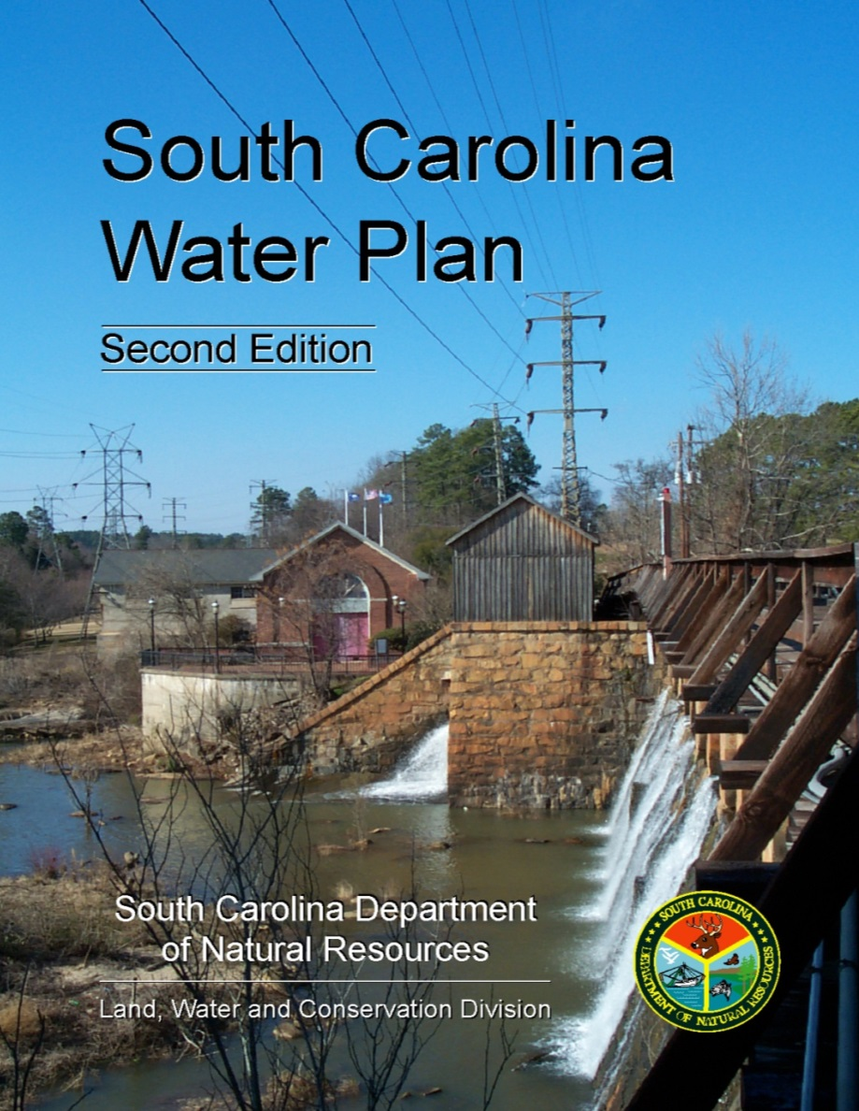
South Carolina Water Plan
In 2004, DNR published the second edition of the South Carolina Water Plan incorporating lessons learned from the drought of 1998-2002.
One recommendation is for the development of regional water plans for each major river basin in the State.

Slide 3
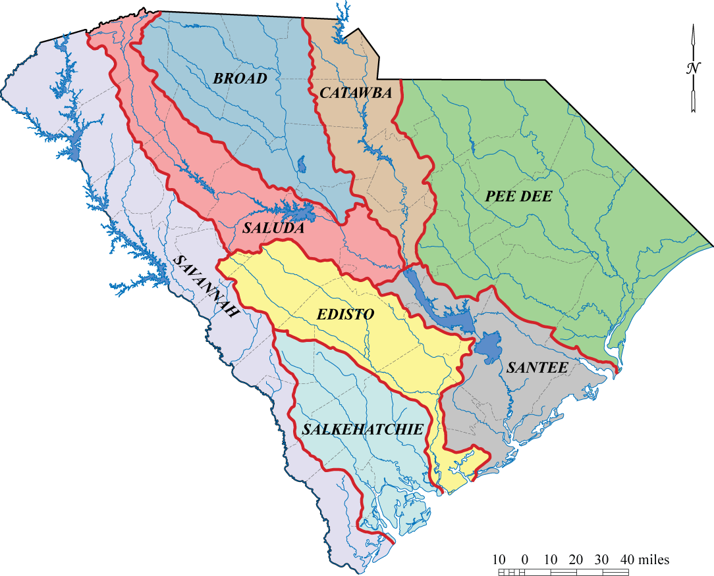
South Carolina’s 8 major river basins
Regional water plans will be developed for each of these basins, the same basins used by DHEC for water-quality assessments and for managing interbasin transfers of water.
Notes:
Together with DHEC, it was decided that the regional planning areas should coincide with river basins and that we should use the same basin designations that are used by DHEC in their watershed water quality assessments and for IBT permits.

Slide 4
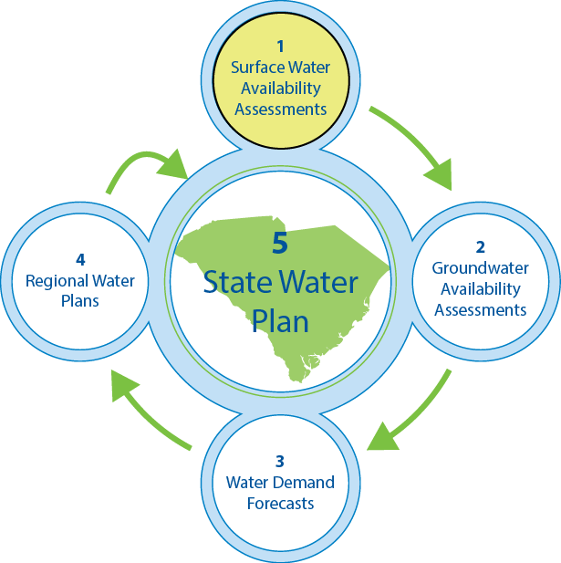
Step 1…
Surface water quantity models
Development of the surface water models is just the first step in the development of regional and statewide water plans.

Slide 5
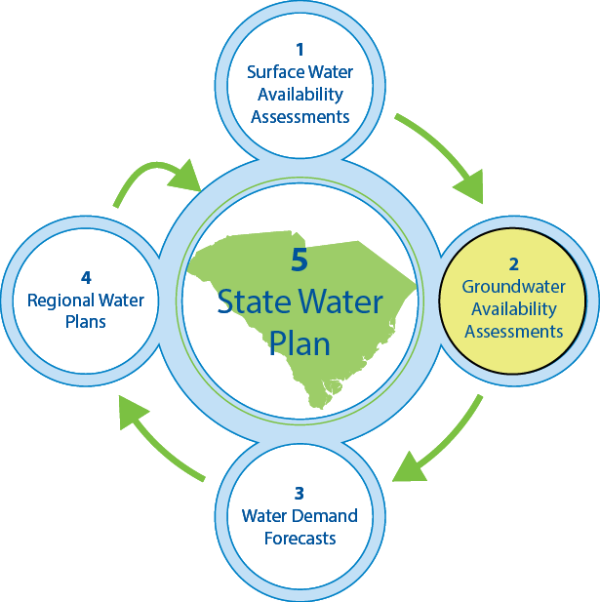
Step 2…
Groundwater flow models
Groundwater models will be used to predict the impacts of groundwater withdrawals on aquifers, streamflows, and on other users of the aquifer.

Slide 6
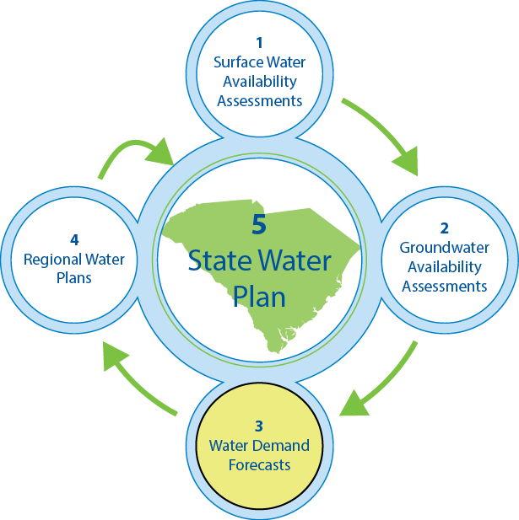
Step 3…
Water-demand forecasts
Water-demand forecasts will be made for agriculture, energy, industry, and public-supply at 5-10 year intervals over a 50-year planning period.

Slide 7
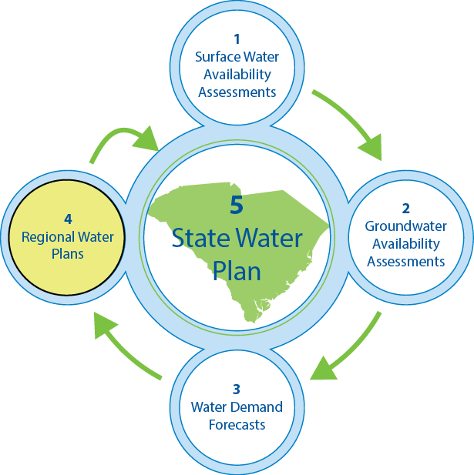
Step 4…
Regional (basinwide) water plans
Using the models and forecasts, and with oversight from State agencies, stakeholders will begin the process of developing regional water plans for each basin.
An analysis to determine if any water deficits will occur
Management strategies to meet the future demands
Water conservation and drought management recommendations

Slide 8
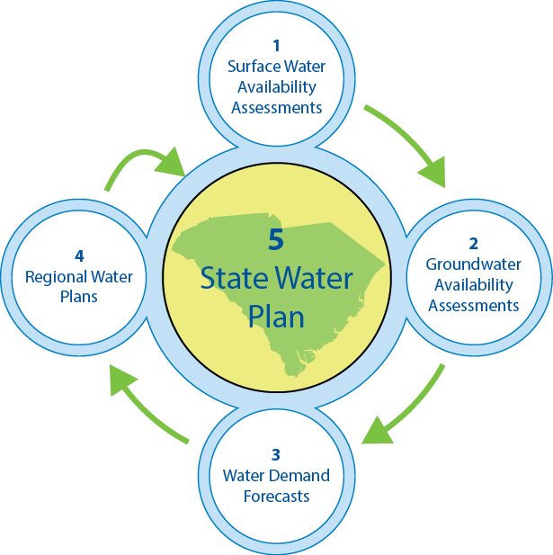
Step 5…
State water plan
Upon completion of the regional water plans, the State water plan will be updated by DNR.
Assess the overall condition of water resources in the State
Evaluate statewide trends in water use and availability
Offer water-resource policy and program recommendations
Introduce innovative practices

Slide 9
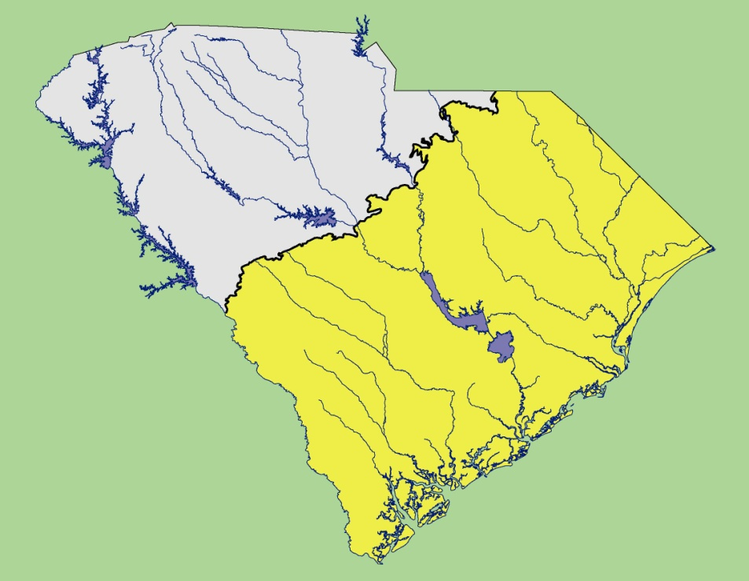
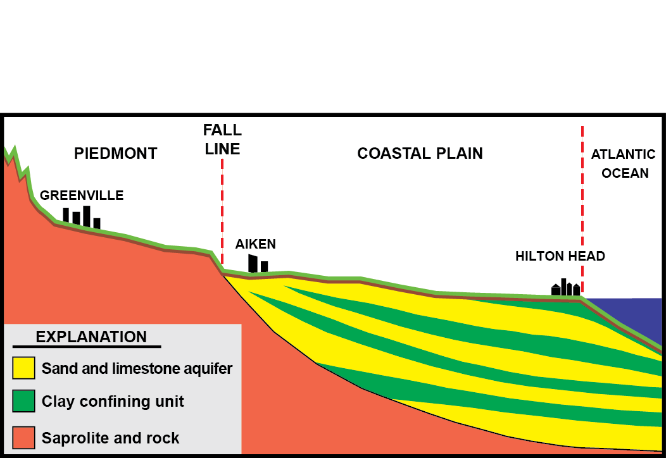
Piedmont
LINE
Coastal
Plain
FALL
Piedmont
Coastal Plain
3,800 ft

Slide 10
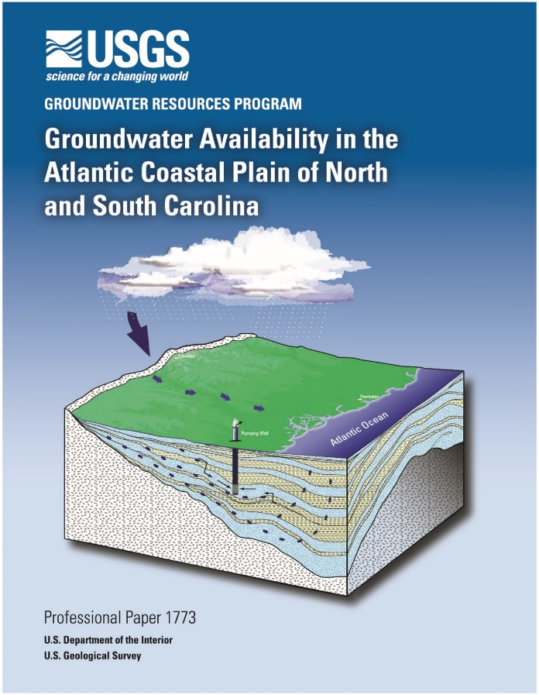
Groundwater Model
Three-year cooperative project with the U.S. Geological Survey.
Purpose: Update the 2010 groundwater flow model of the SC Coastal Plain.
2010 model report
Project members:
Bruce Campbell (lead) – USGS (Columbia)
Greg Cherry – USGS (Atlanta)
Jason Fine – USGS (Raleigh)
Alex Butler (lead) – SCDNR (Columbia)
Joe Gellici – SCDNR (Columbia)
Andrew Wachob – SCDNR (Columbia)
http://pubs.usgs.gov/pp/1773/
Notes:
Pot maps.

Slide 11
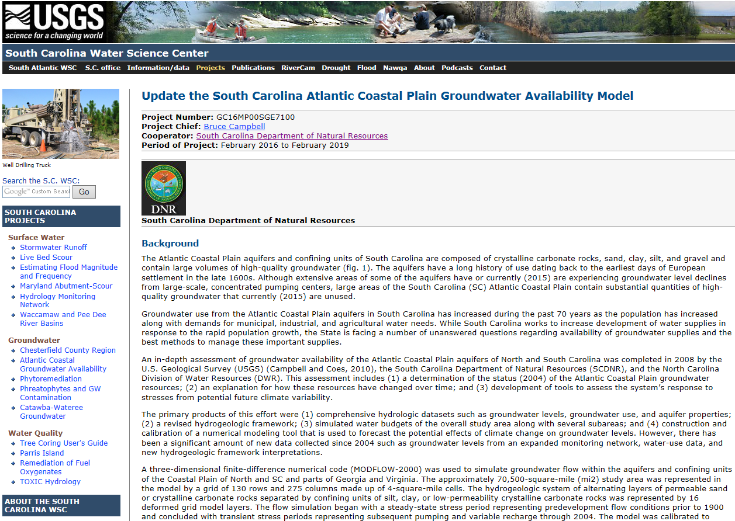
Groundwater Model
USGS webpage for the project
http://sc.water.usgs.gov/projects/gw_availability2/

Slide 12
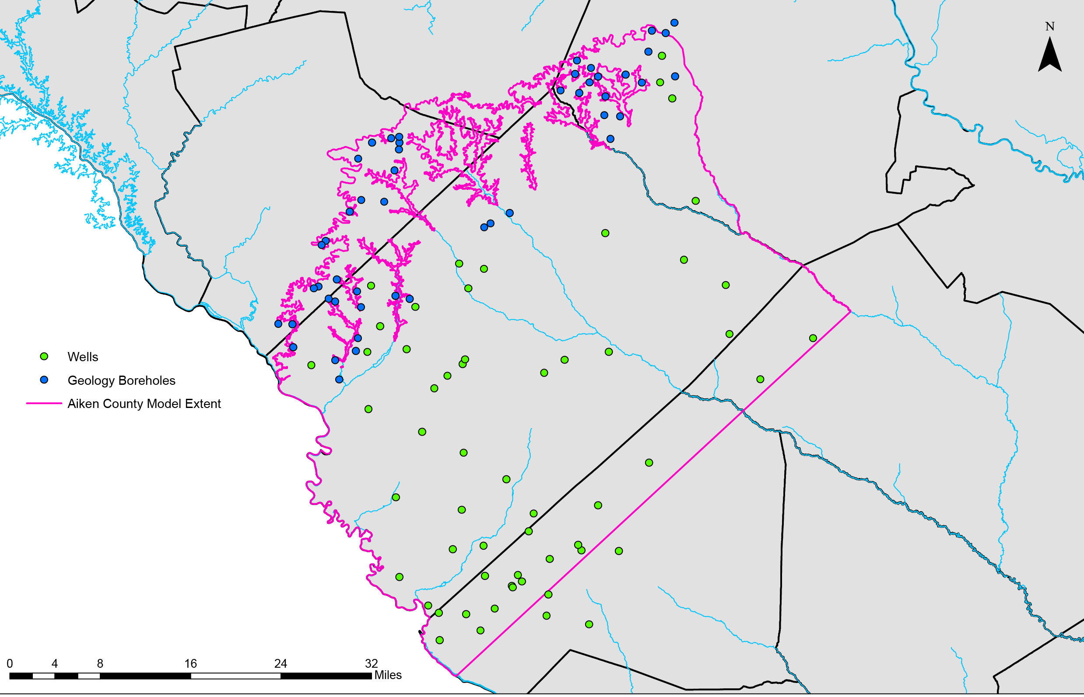
Aiken County Groundwater Model
Three-year cooperative project with the U.S. Geological Survey.
Purpose: Develop a detailed groundwater flow model of Aiken County.
Wells and coreholes
Geology boreholes
Aiken County model extent
Wells and boreholes used to develop hydrogeologic framework
Notes:
The pink outline shows the modeling area. The green dots show the locations of monitoring and production wells that will be used to create the hydrogeologic framework of the county. The blue dots are boreholes drilled by the S.C. Geological Survey, which will also be used in the construction of the framework.

Slide 13
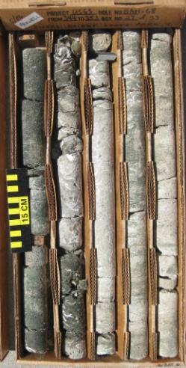
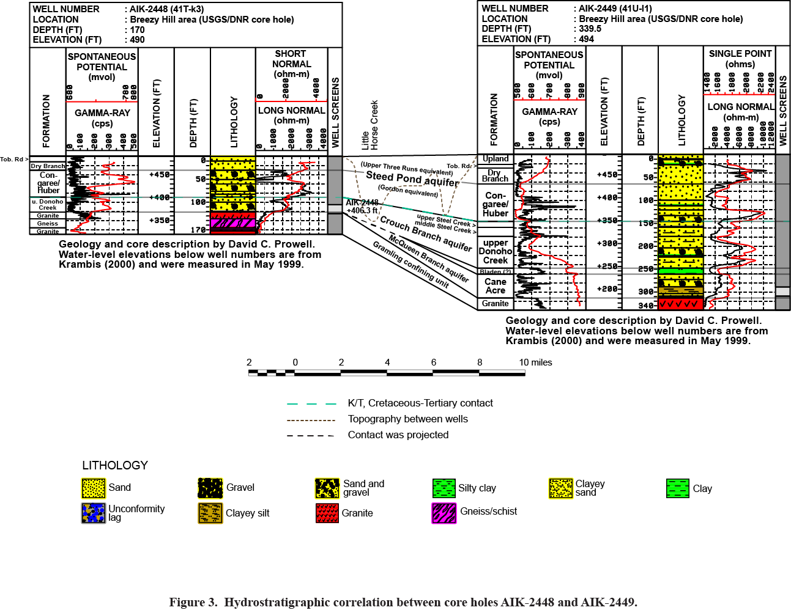




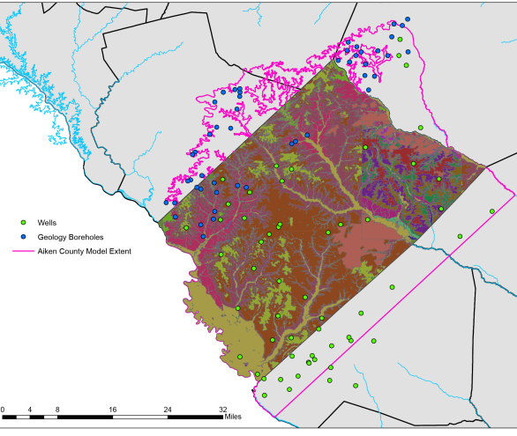
Core samples and
drill cuttings
Geophysical logs
Fossil data
Geologic maps
Notes:
Information from the wells and boreholes include lithology from core samples and drill cuttings, geophysical logs, information about the age of the layers (obtained from microfossils), and geologic maps.

Slide 14
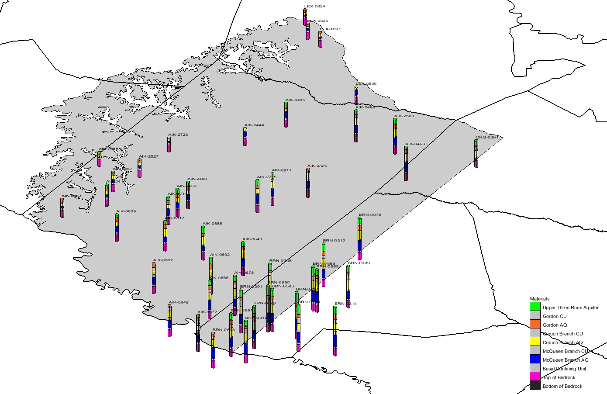
Aquifers and confining units are delineated at each well
Notes:
Aquifers and confining units are delineated at each well and borehole to produce the hydrogeologic framework, which is the 3-dimensional spatial representation of the groundwater system. The framework is a 3-dimensional map of the subsurface showing the thicknesses, depths, and lateral extents of the aquifers and confining units.

Slide 15
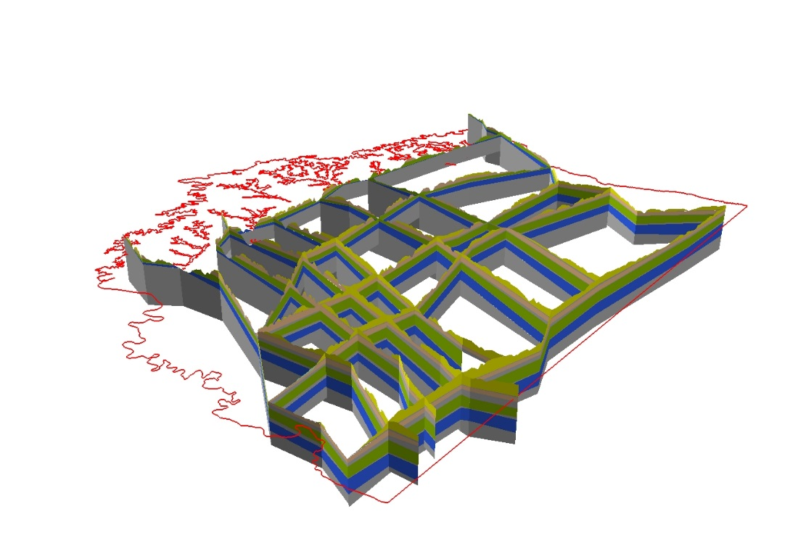
A fence diagram depicting aquifers and confining units in Aiken County.

Slide 16
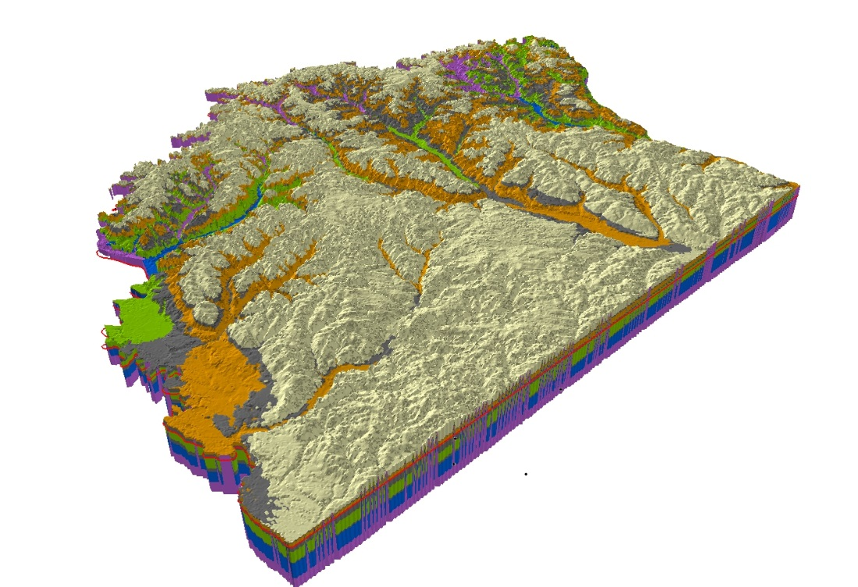
A 3-D hydrogeologic framework generated from the fence diagram using ARC-Hydro software.

Slide 17



Aiken County Groundwater Model
.
http://sc.water.usgs.gov/projects/aiken gw/
Bruce Campbell (lead) – USGS
Jim Landmeyer – USGS
Alex Butler – SCDNR
Joe Gellici – SCDNR

Slide 18
The model will be used to:
Determine groundwater availability.
Evaluate the impacts that pumping has on groundwater and surface water resources and on other groundwater users.
Evaluate future withdrawal scenarios to maximize groundwater use and minimize undesirable effects of pumping.

Slide 19
Examples of scenarios that can be tested with the model
SCENARIO 1
Base Case: A “base case” simulation comprised of pumping existing wells at their reported 2015 withdrawal rates out to year 2050.
SCENARIO 2
Increased Groundwater Withdrawals: The 2015 withdrawal rates will be increased by 0.5 percent per year to 2050. This scenario will also include any planned future wells and their assumed withdrawal rates.
SCENARIO 3
Drought: The effect of a 10-year drought will be simulated for the years 2020-2030 by reducing the annual average recharge rates by 5 to 10 percent.

Slide 20
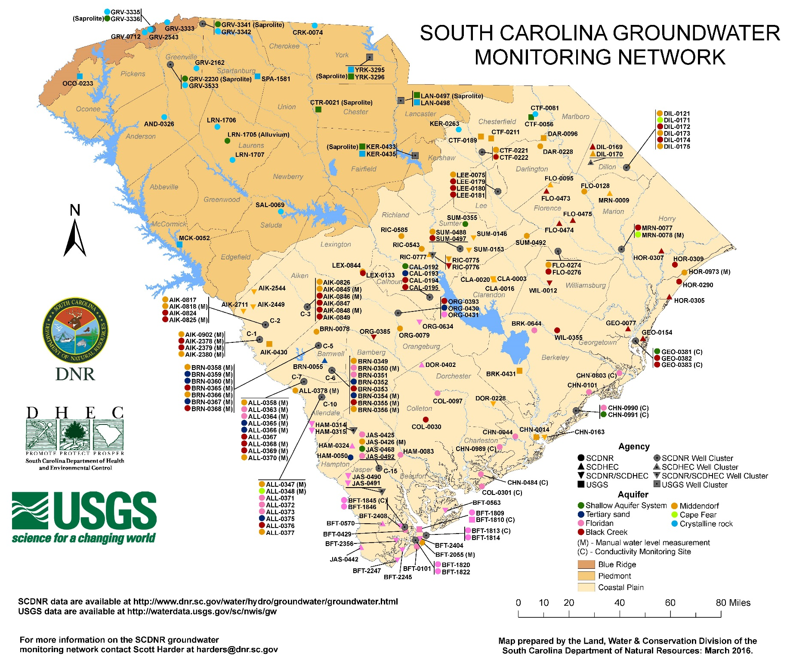

Slide 21
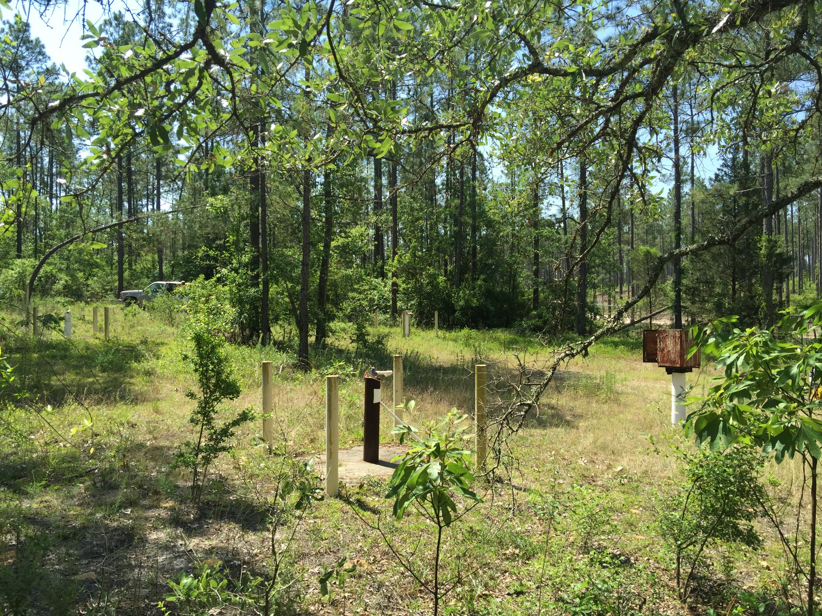
Groundwater Monitoring Site
Aiken State Park
Site C-3

Slide 22
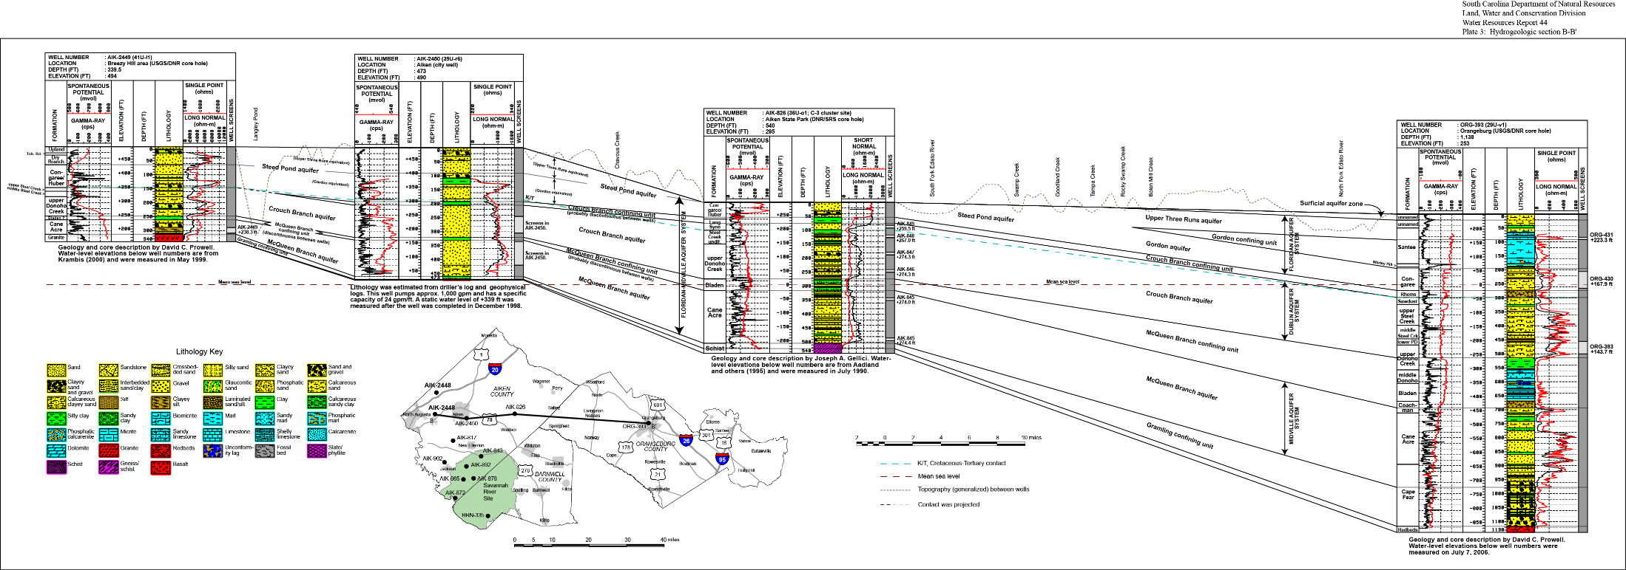
C-3 Hydrostratigraphy
Sand
Sand and gravel
Clay
Bedrock (schist)
Tertiary sand aquifer (Gordon)
Black Creek aquifer
(aka, Crouch Branch)
Confining unit
Middendorf aquifer
(aka, McQueen Branch)
Bedrock

Slide 23
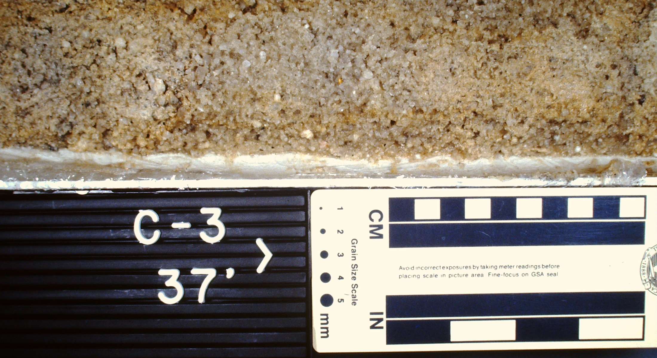
Tertiary sand aquifer
37 ft

Slide 24
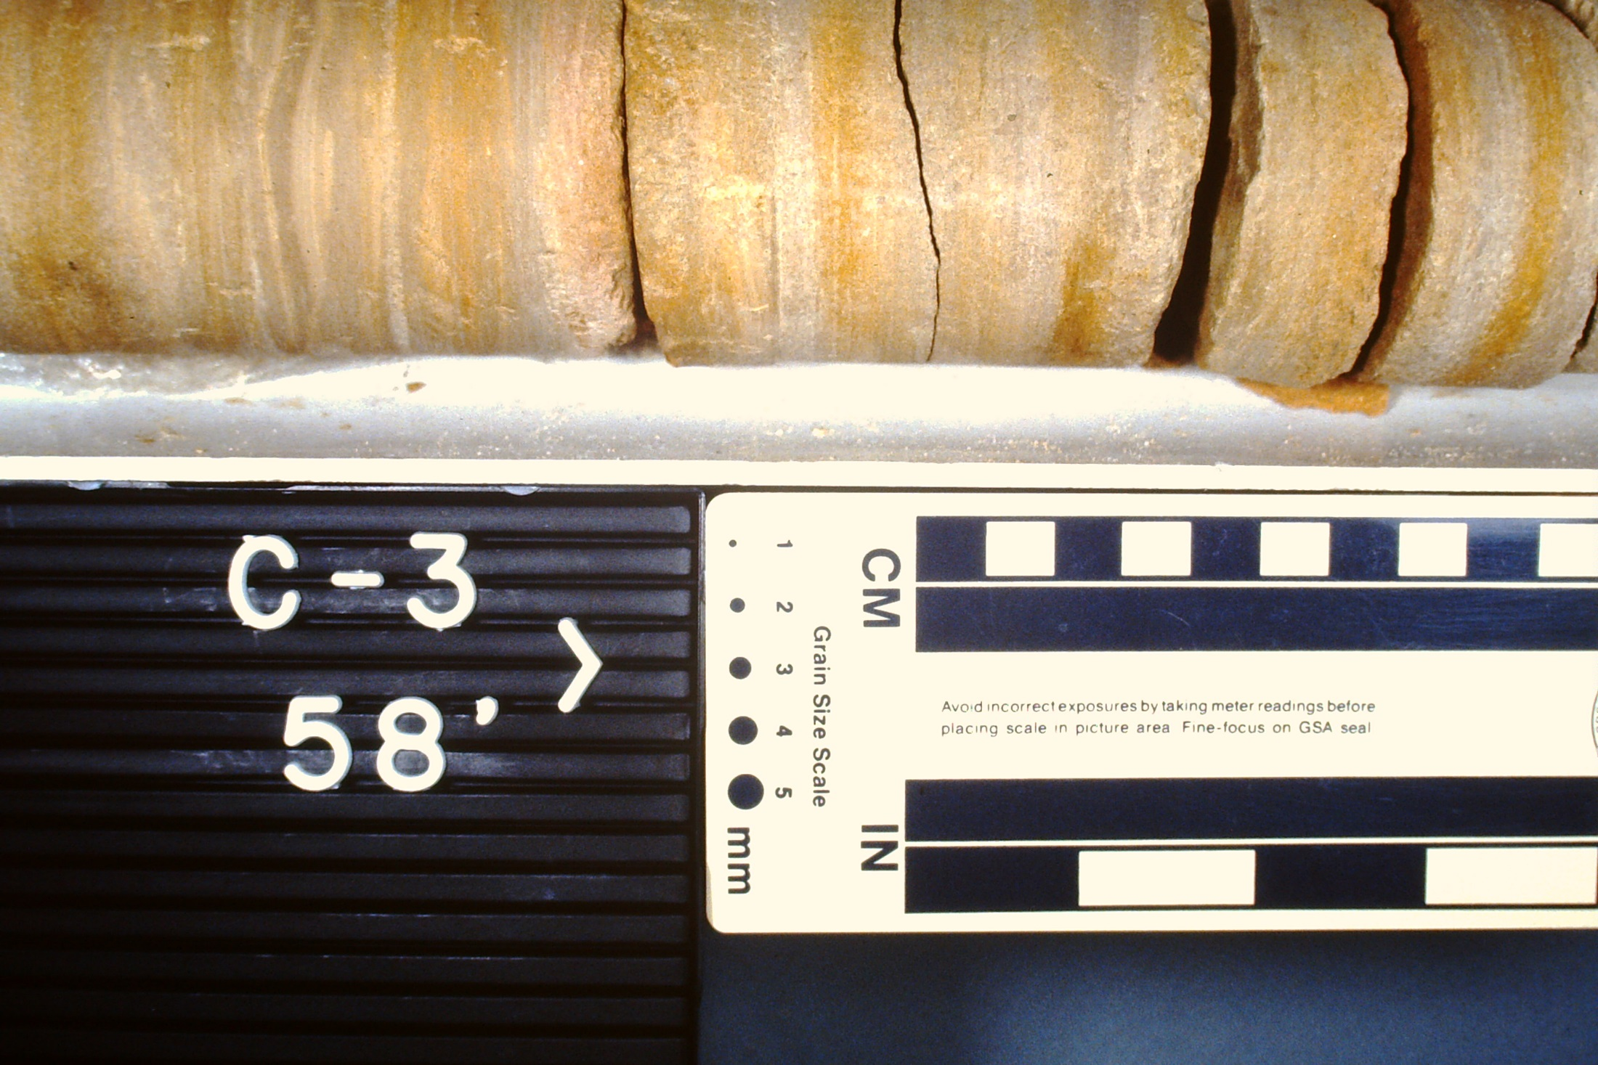
Confining unit separating the Tertiary sand aquifer from the underlying Black Creek aquifer
58 ft

Slide 25
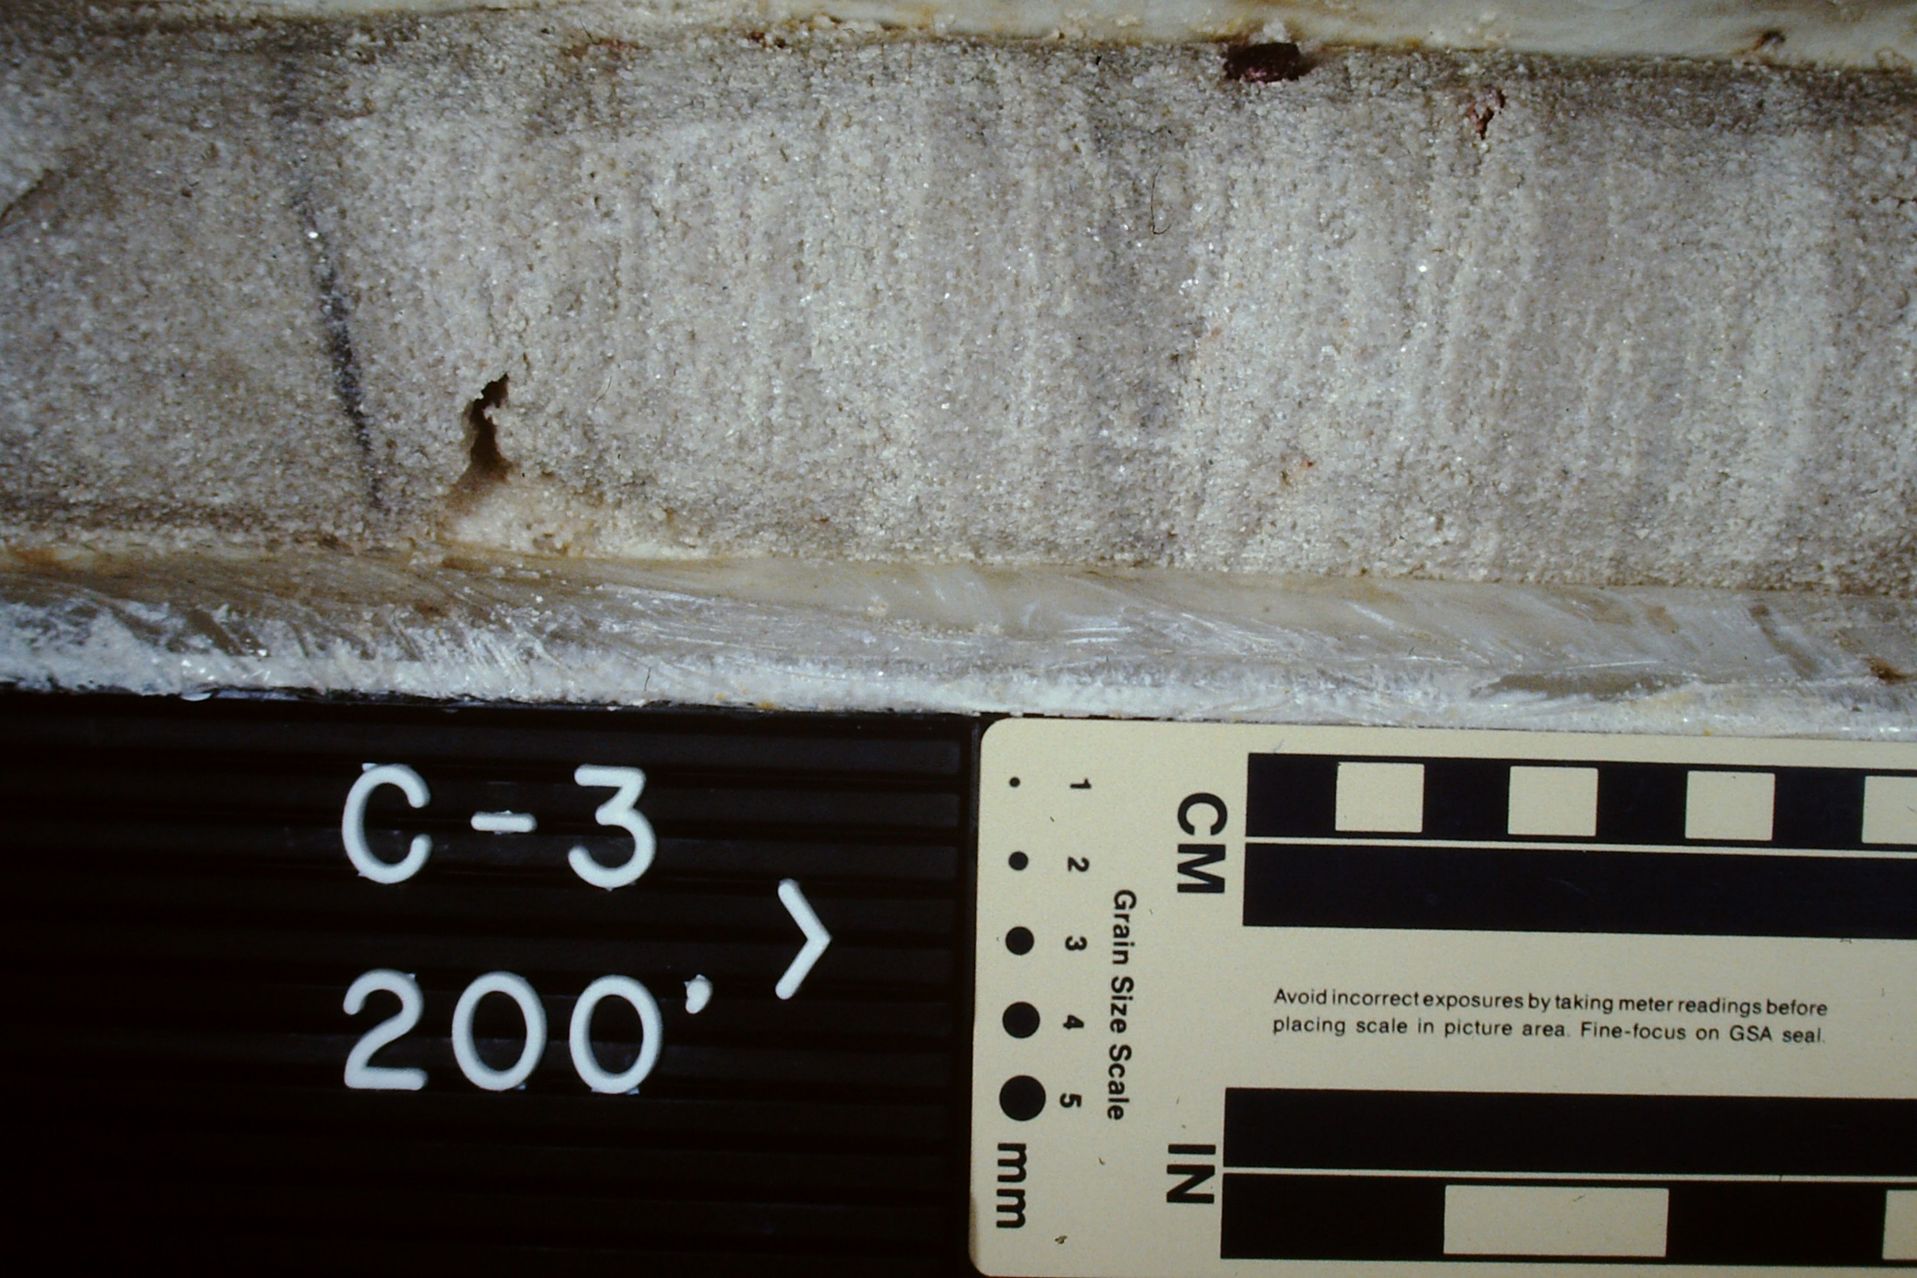
Black Creek aquifer
200 ft

Slide 26
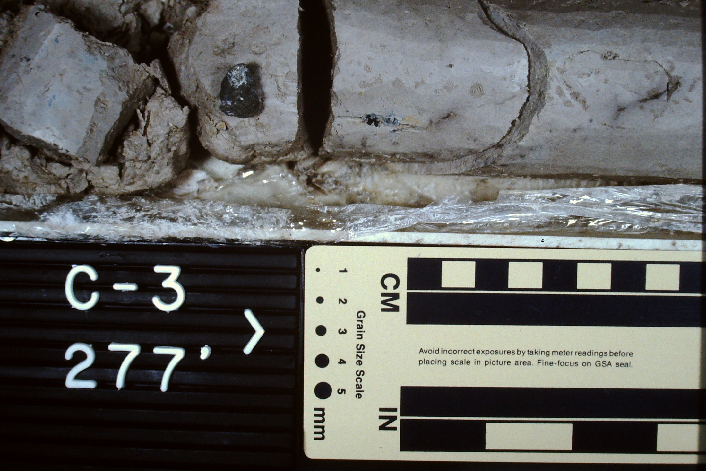
Confining unit separating the Black Creek aquifer from the Middendorf aquifer
277 ft

Slide 27
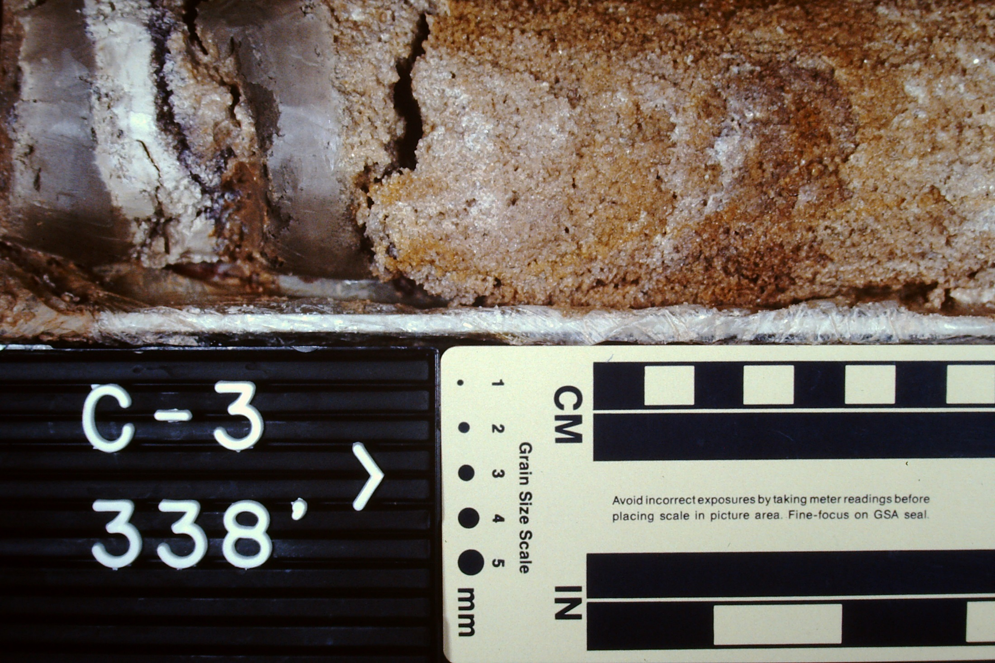
Middendorf aquifer
338 ft

Slide 28
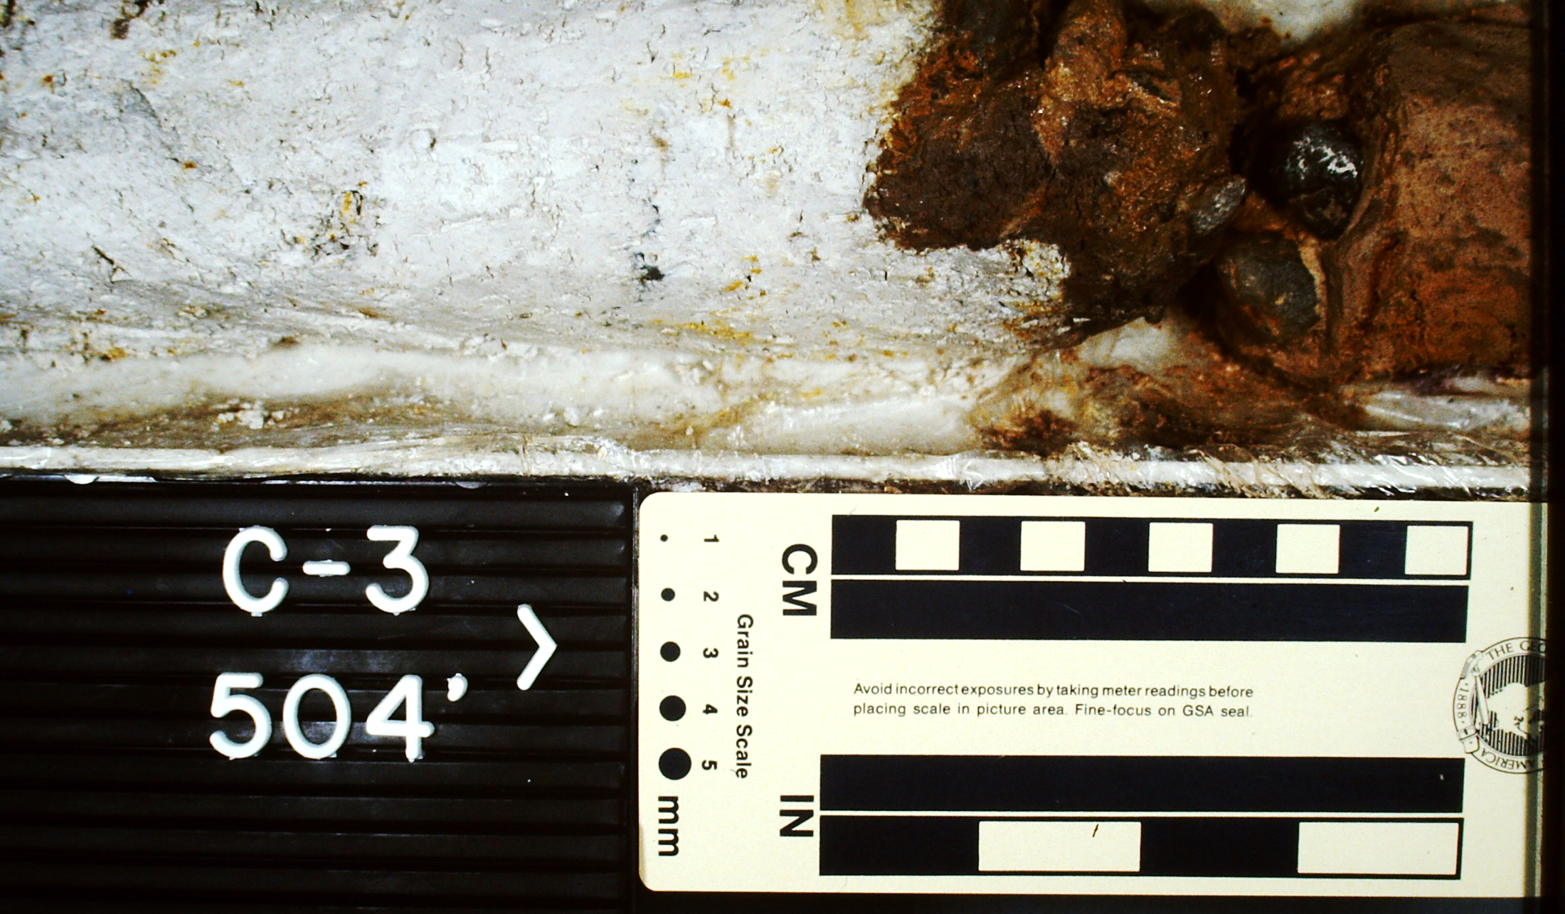
Contact between Coastal Plain and bedrock
504 ft

Slide 29
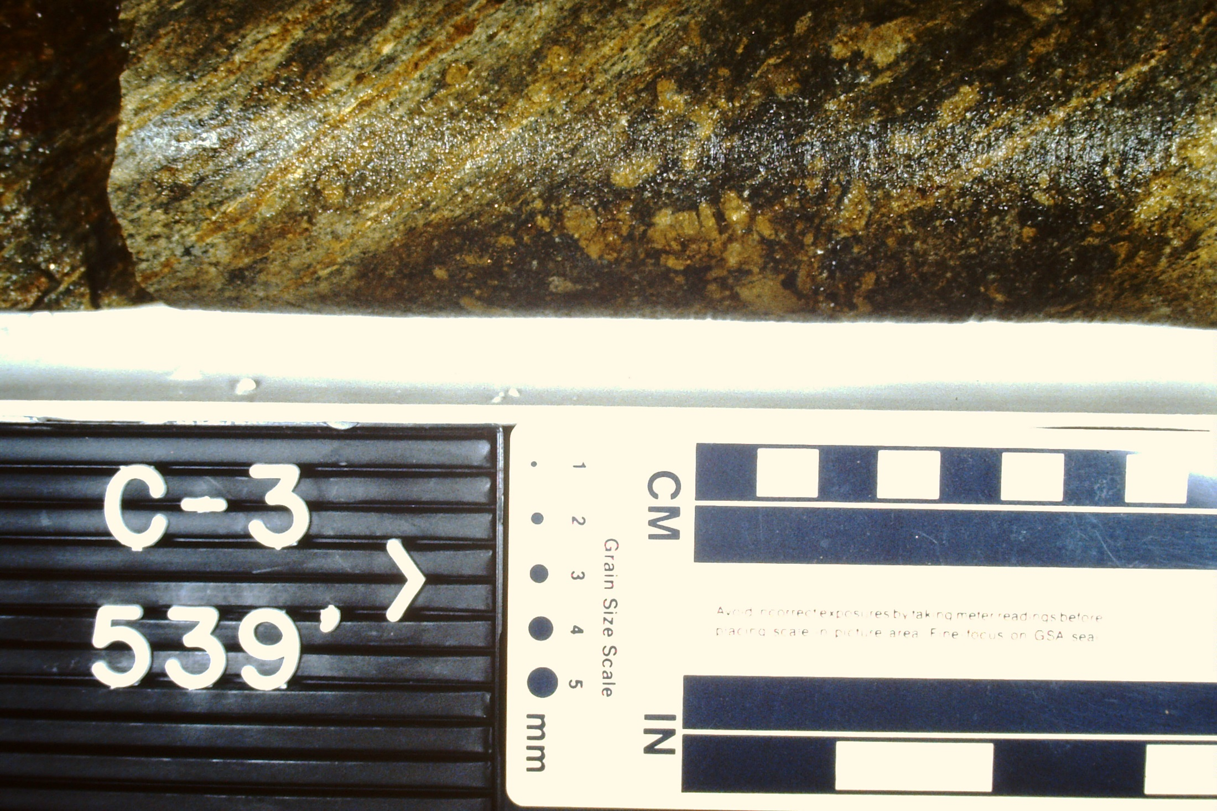
Bedrock (metamorphic rock, schist)
539 ft

Slide 30
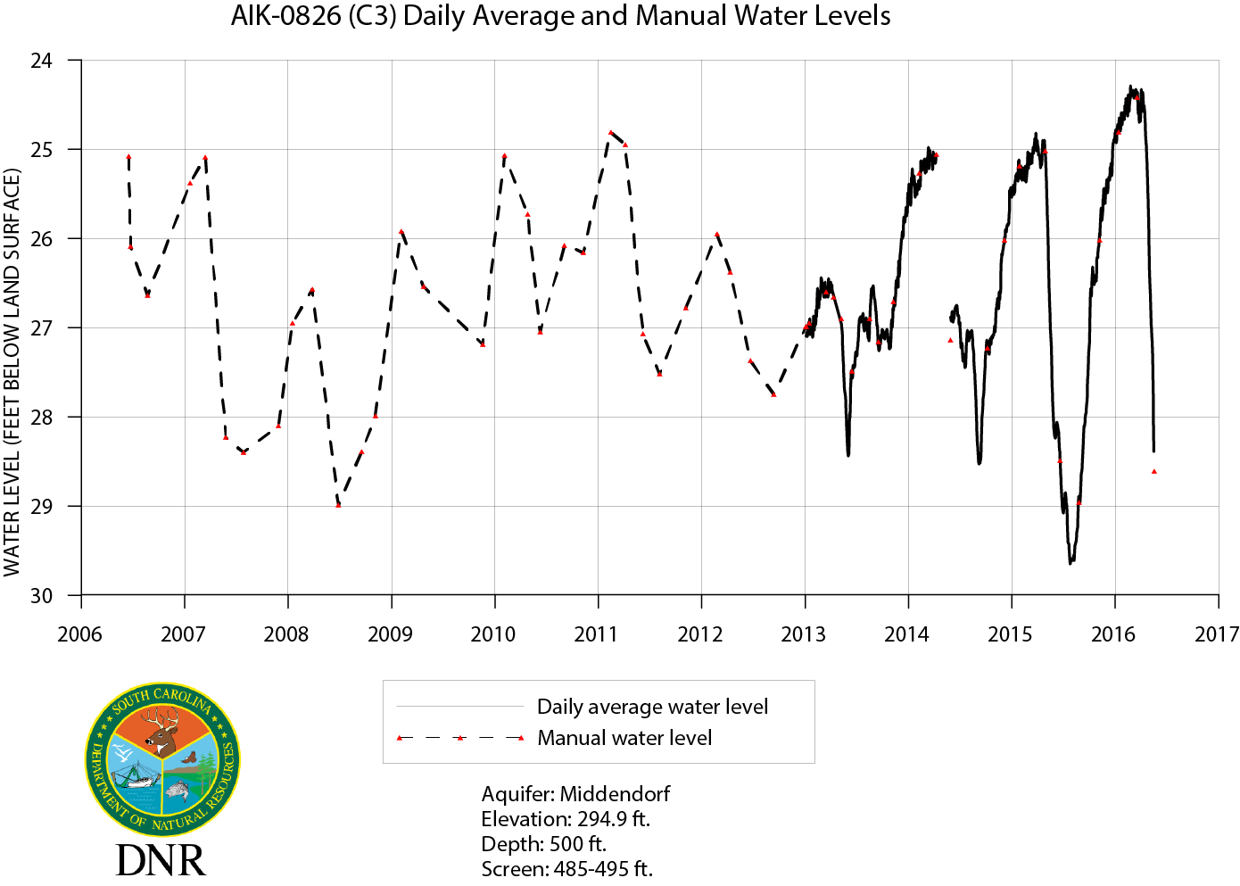
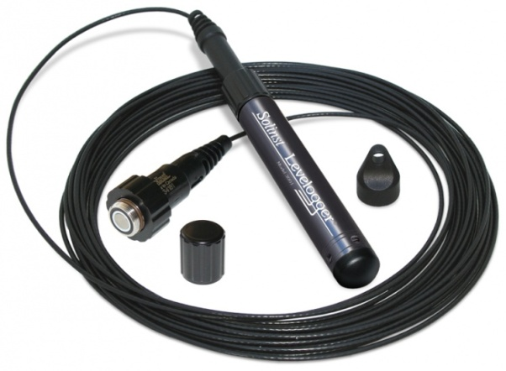
Missing
data
Middendorf aquifer (485-495 ft)
ADR

Slide 31
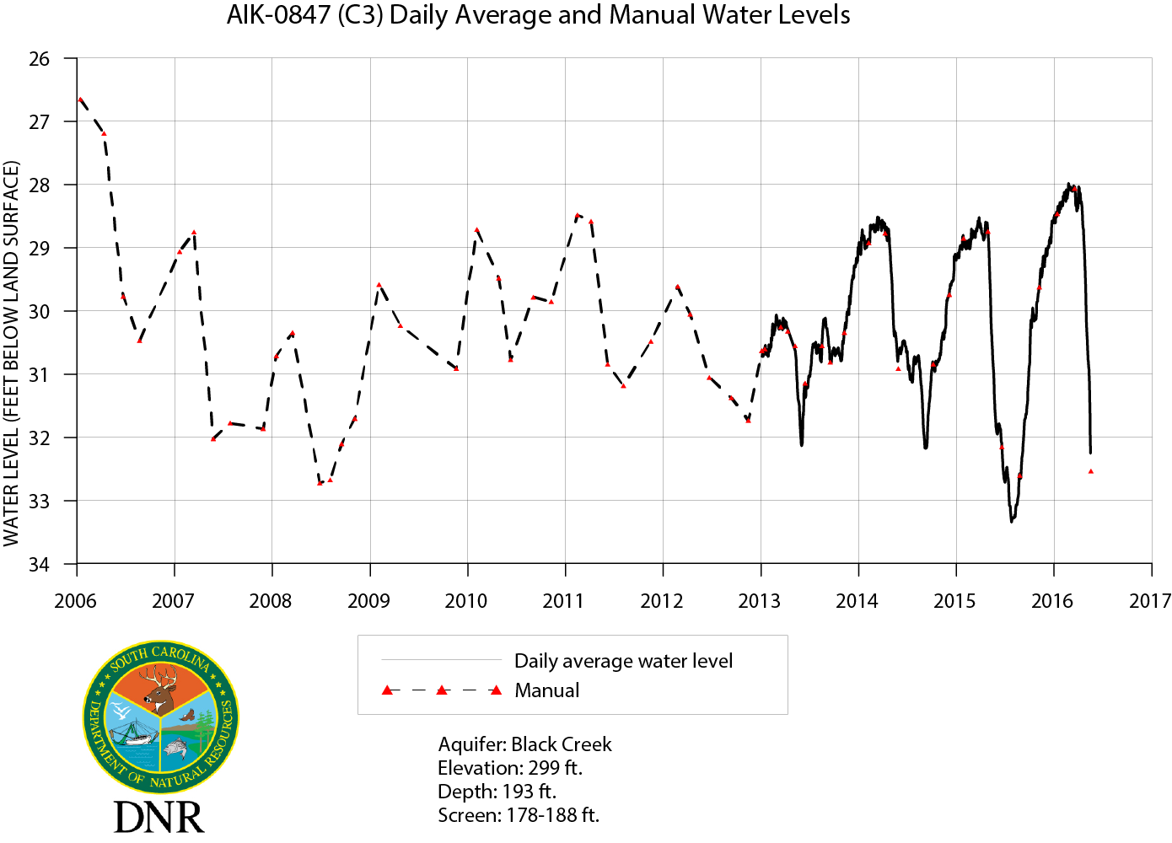
Black Creek aquifer (178-188 ft)

Slide 32
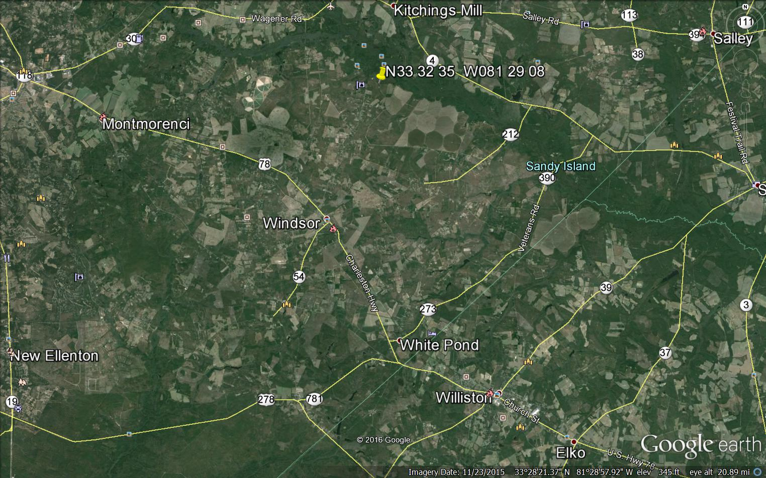
Groundwater Monitoring Sites
C-3 Well cluster Aiken St. Pk.
6 wells from 82 ft to 495 ft
AIK-344 Windsor El. Sch.
Screen 338-404 ft
BRN-78 Town Williston
Screen 568-700 ft
Groundwater Monitoring Site

Slide 33
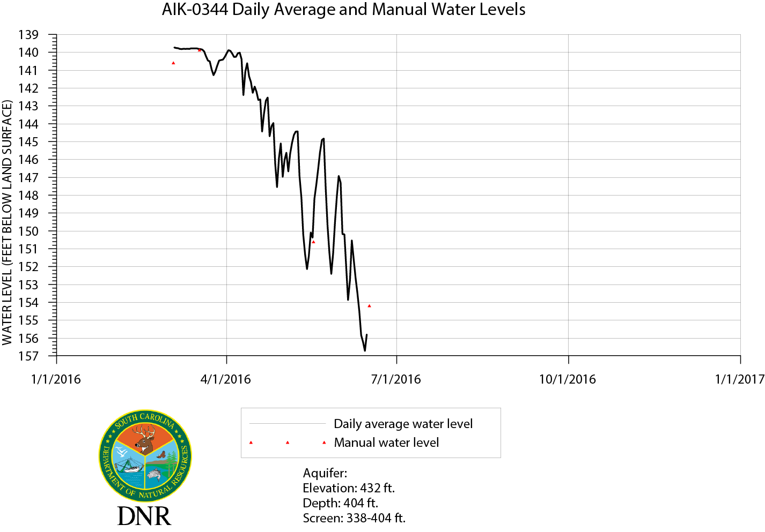

Slide 34
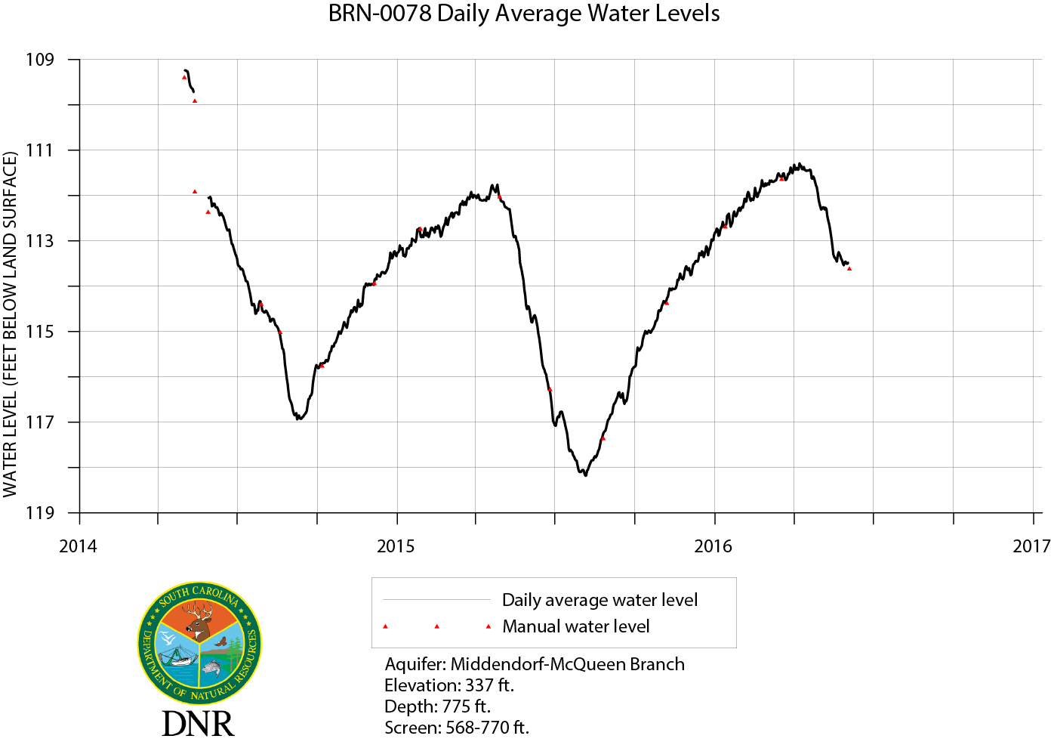
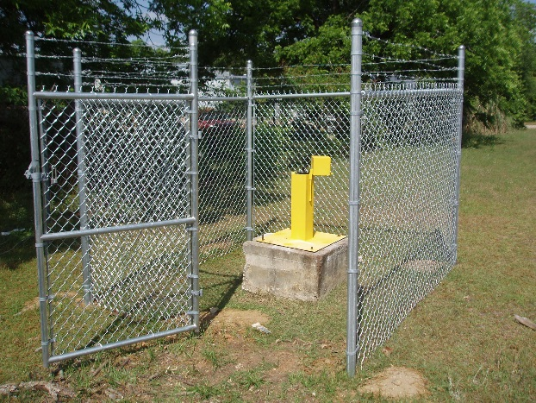

Slide 35
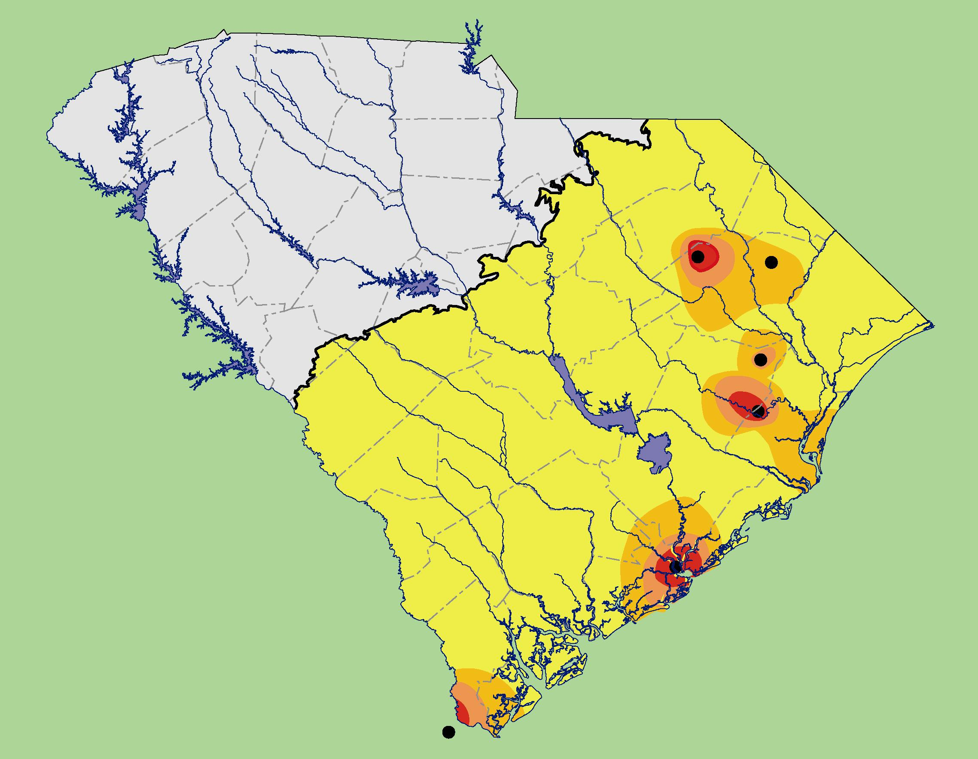
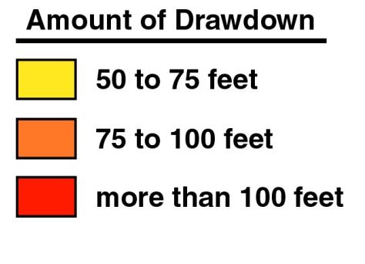
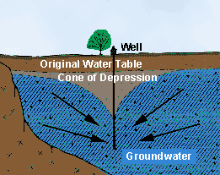
Major cones of depression in South Carolina
200+ foot water-level declines in Middendorf aquifer.
Florence
Marion
Hemingway
Andrews
200+ foot water-level declines in Black Creek aquifer.
Charleston
200+ foot water-level declines in Middendorf aquifer.
Savannah
100+ foot water-level declines and saltwater intrusion

Slide 36
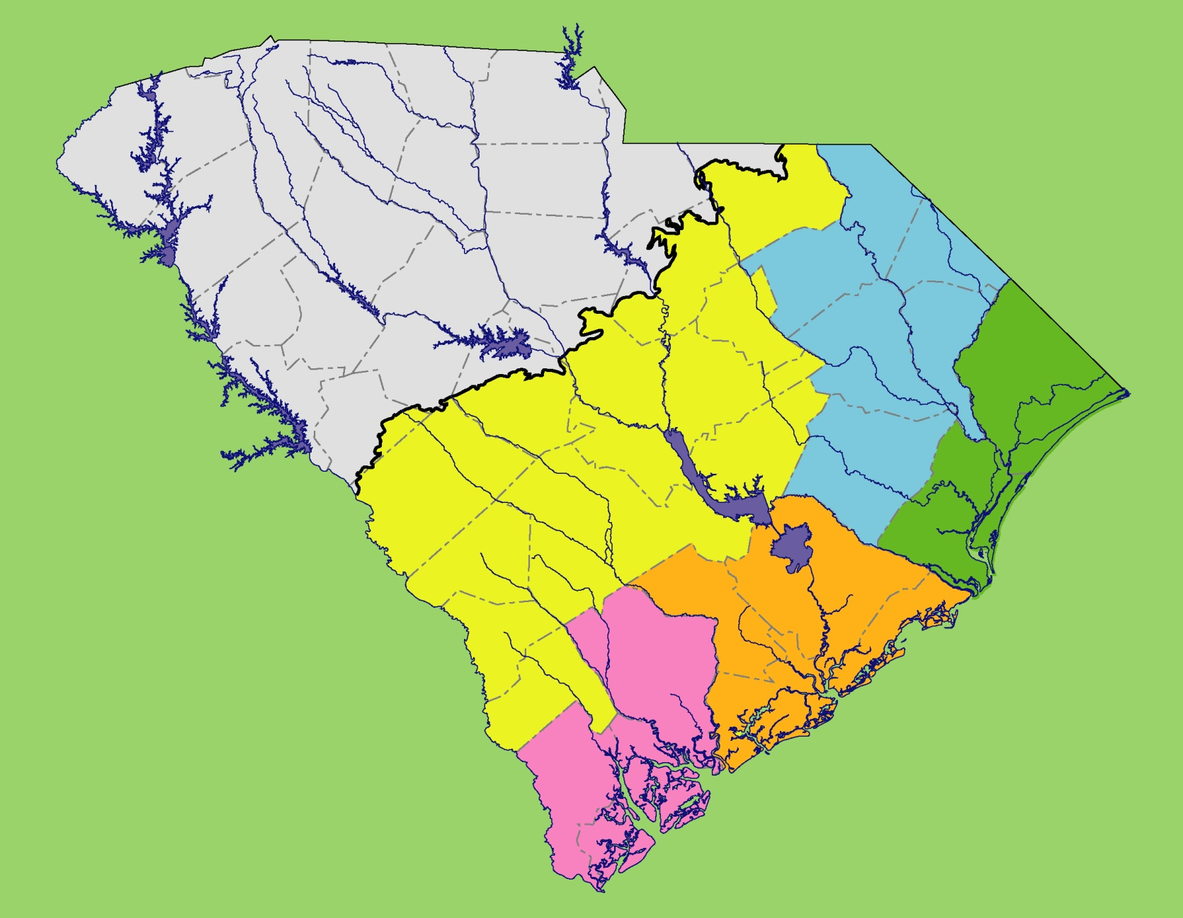
CAPACITY USE AREAS – Areas where groundwater withdrawals are regulated by the State.
PEE DEE
2004
UNREGULATED
UNREGULATED
WACCAMAW
1979
Groundwater withdrawal permits are required to withdraw and use groundwater equal to or greater than three million gallons in any month in the counties in these areas.
TRIDENT
2002
LOW COUNTRY
1981

Slide 37
Thank You
Enjoy the Festival

Slide 38
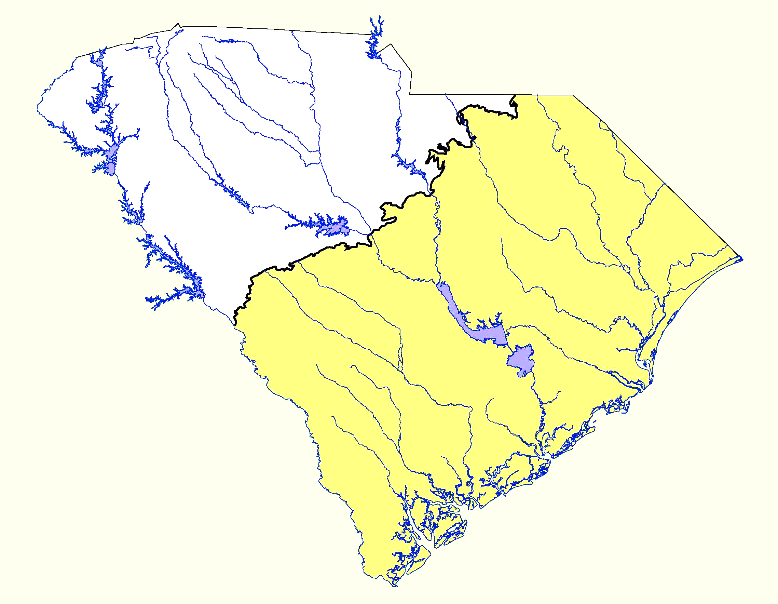
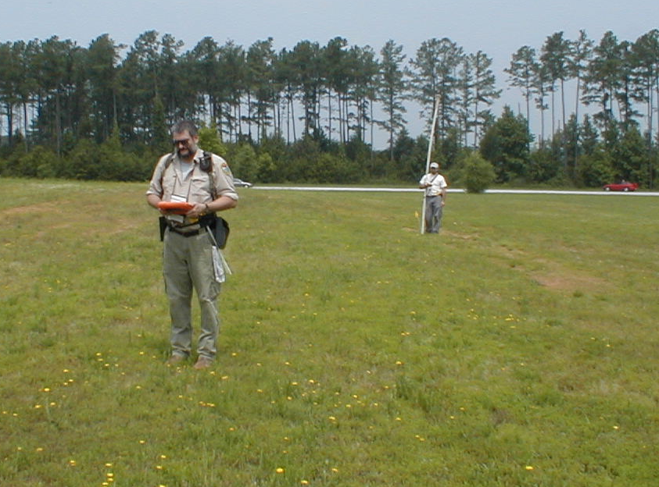
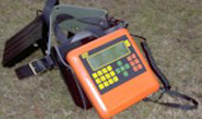
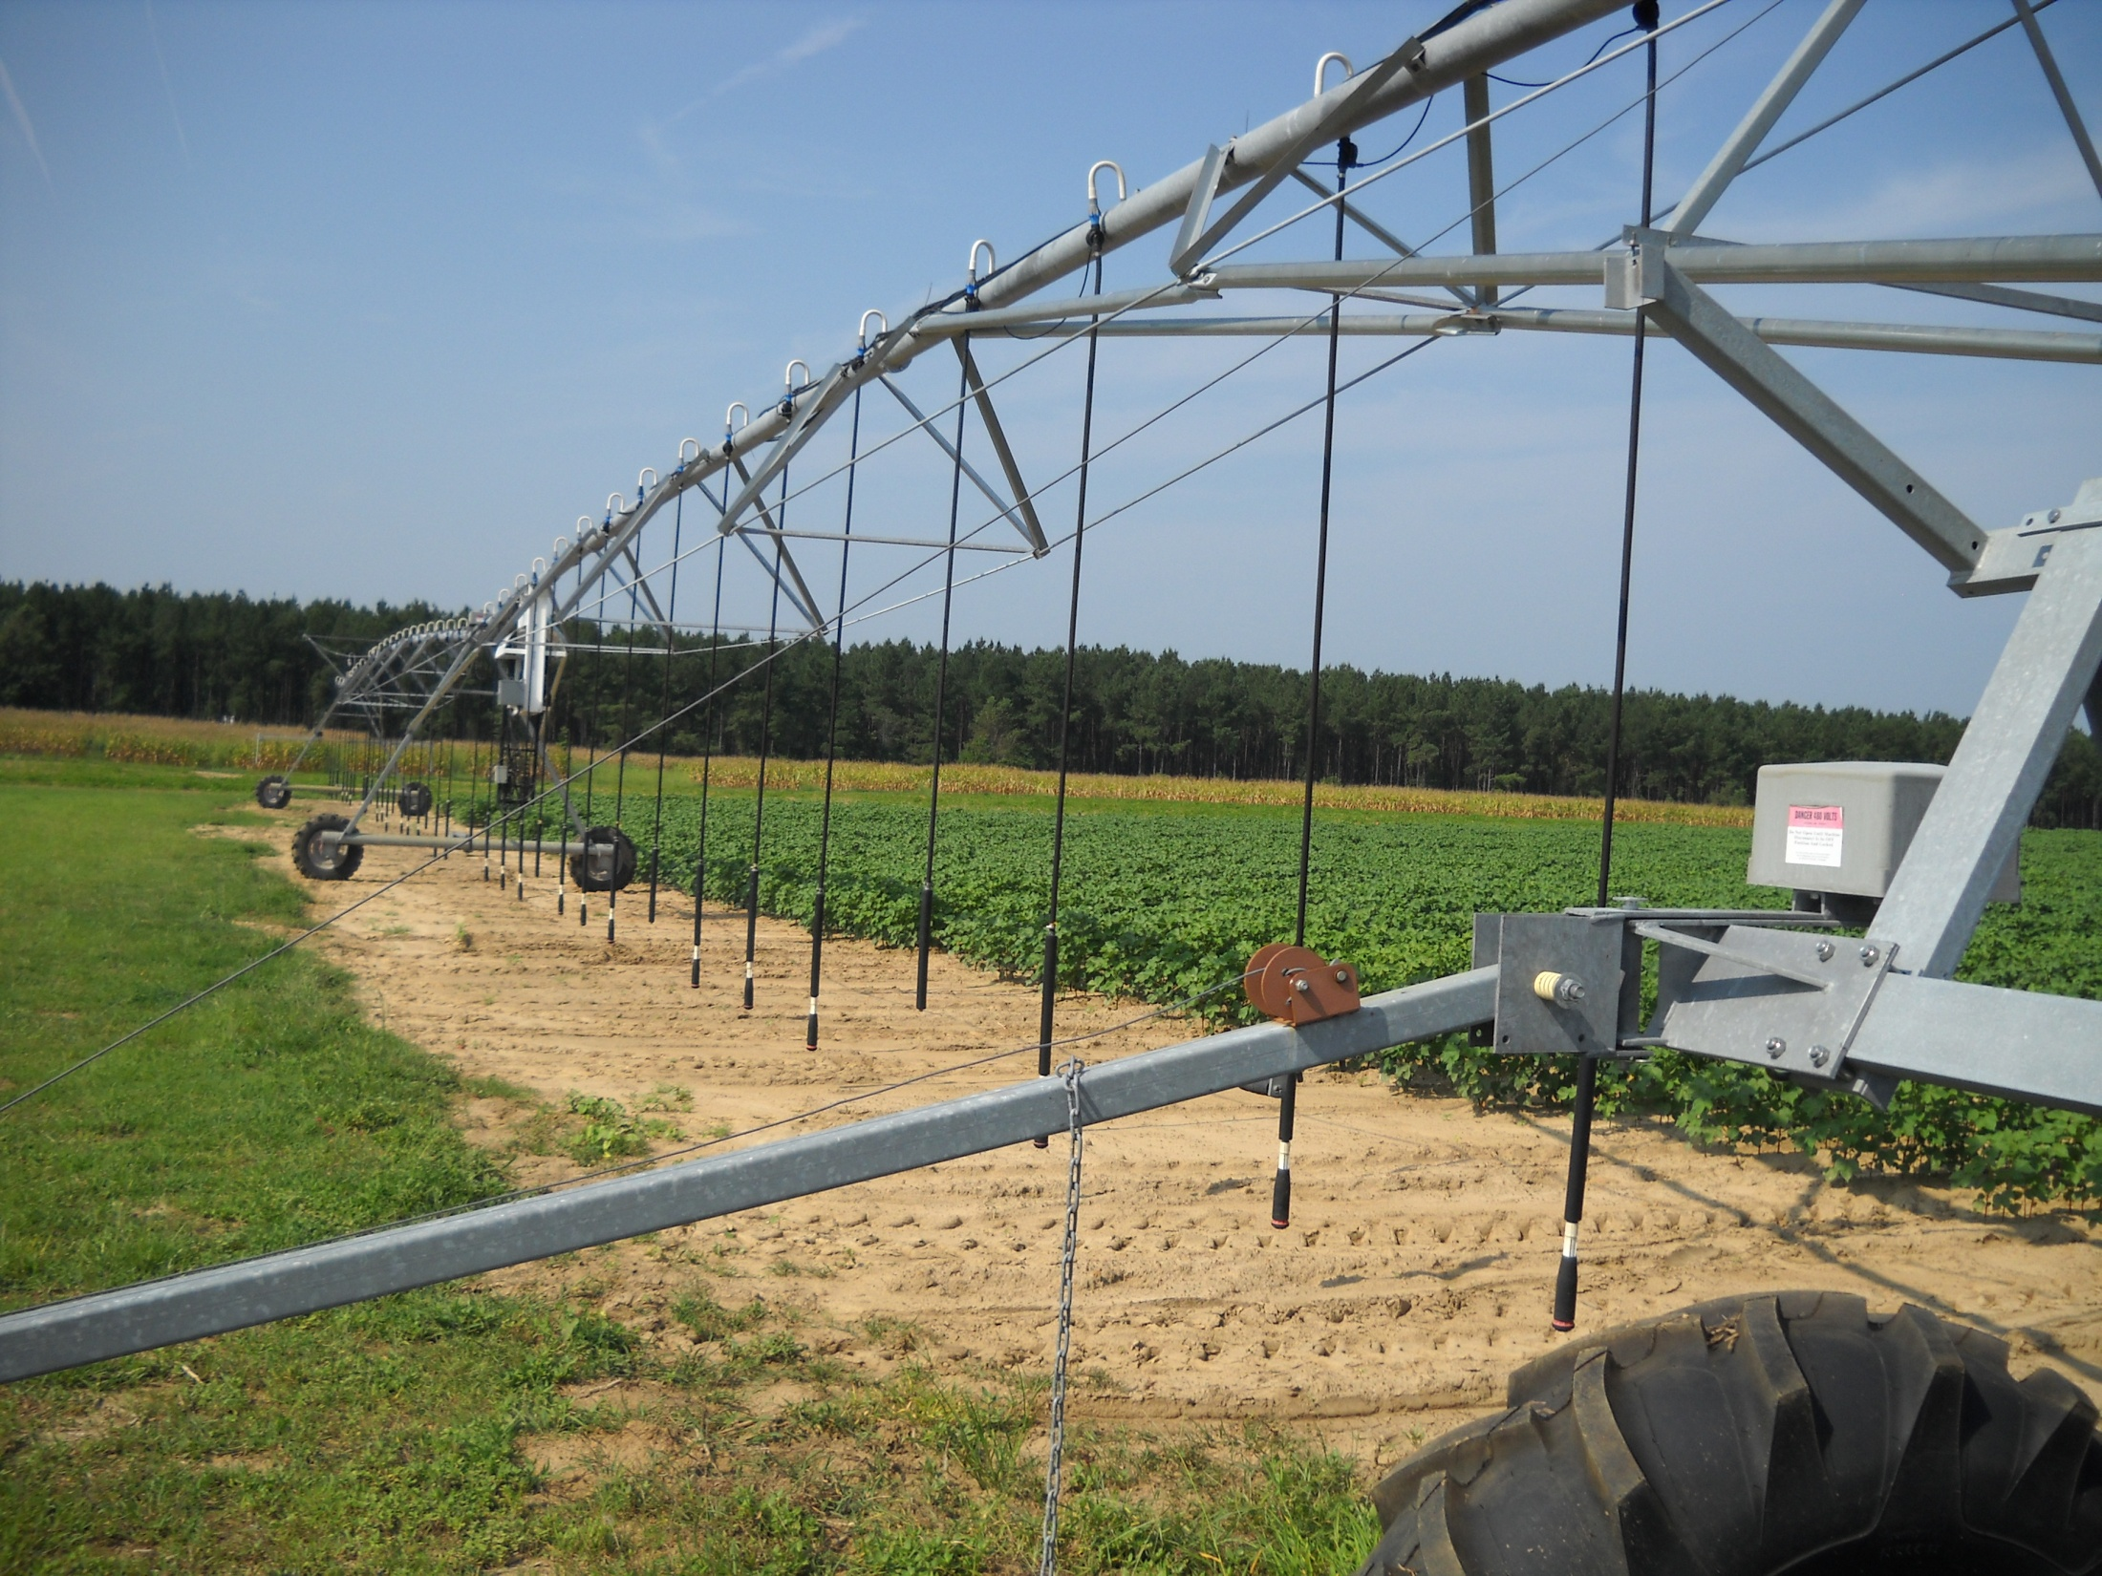
Groundwater occurs just about everywhere.
P i e d m o n t
1–300 gallons per minute from wells
C o a s t a l P l a i n
10–3,000 gallons per minute from wells
Center-pivot irrigation system.
WADI - Detects conductive features in the subsurface (water-filled fractures) using low-frequency radio waves transmitted by the Navy.

Slide 39
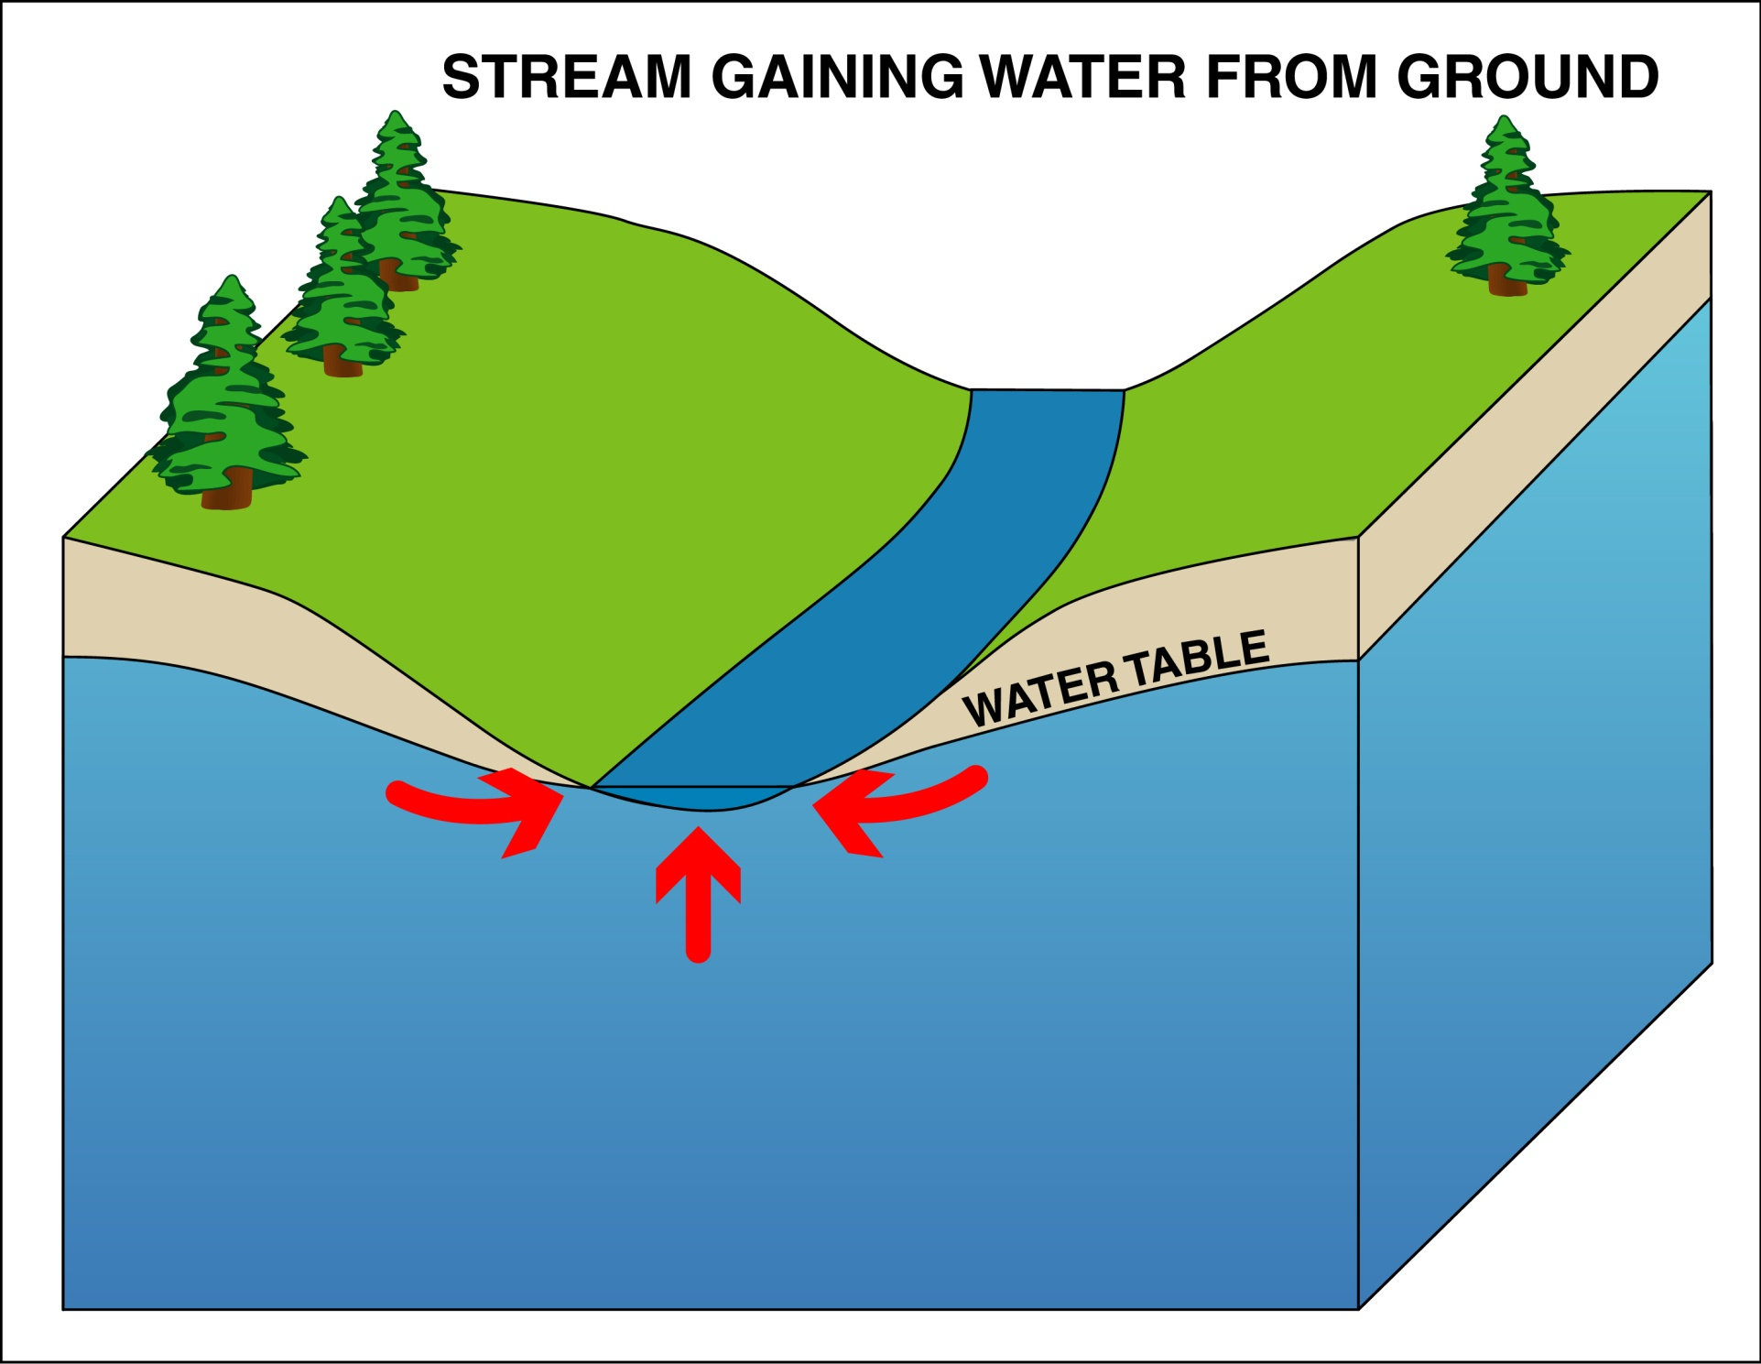
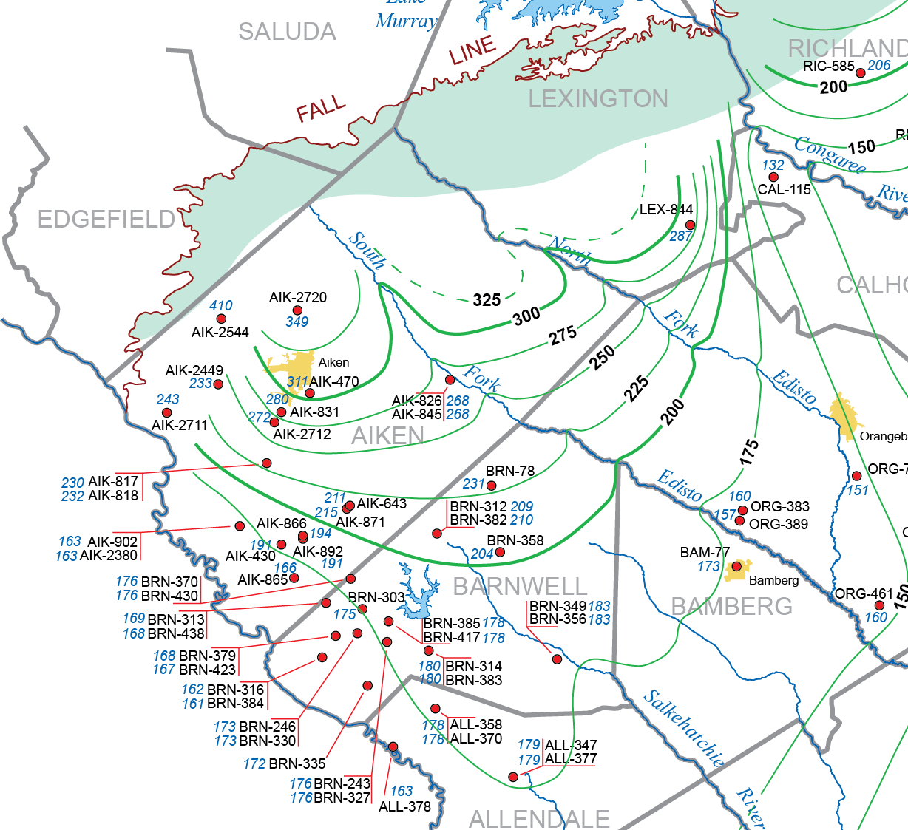
Groundwater and surface water are connected.
Direction of
groundwater
movement

Slide 40
Potentiometric map of the Middendorf/McQueen Branch aquifer
Direction of
groundwater
movement

Slide 41
Automated water-level data recorder (ADR)

Slide 42


Slide 43
Updates to the model will include:
Activating the surficial aquifer model layer
Adding recent groundwater-related data (2005-2015)
Hydrostratigraphic data
Water-use data
Aquifer tests
Refining the model grid in some areas
Incorporating a more detailed representation of the Fall Line area
Re-calibration
Applying the model to a series of 6 scenarios

