Slide 1
Safe Yield and Minimum Instream Flow
SWAM Update
Where to from here?
Provide an update on the modelling process. Where are we and where are we going?
How does the law look in light of model results?
“…effectively disseminate as much information to the public and our membership as we can, as it is developed, about the Edisto.” Ted Rogers

Slide 2
cfs = Cubic Feet per Second
MGD = Million Gallons per Day
MGM = Million Gallons per Month
3 MGM = 100,000 MGD = 0.15 cfs

Slide 3
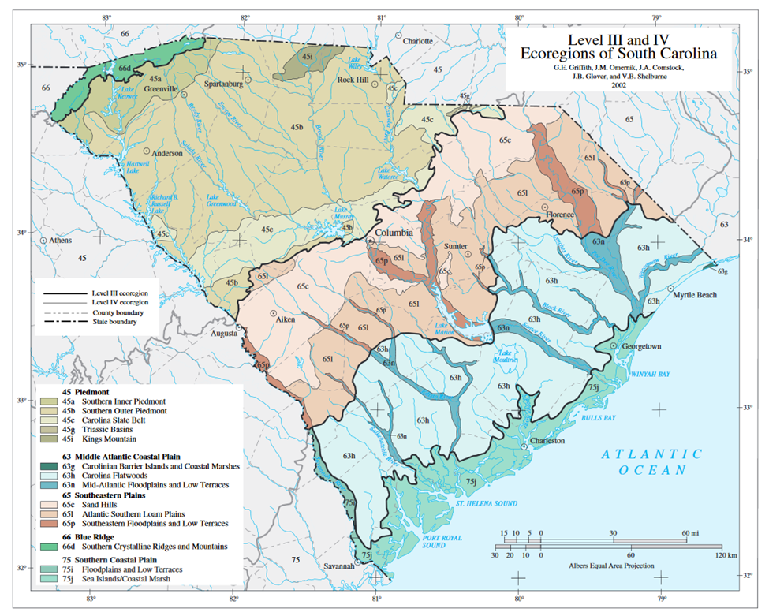

Slide 4
Safe Yield and Minimum Instream Flow
Who has read the Bill? Do you approve or disapprove?
Who has read the regulations? Do you approve or disapprove?
Who was at the meeting over a year ago in Aiken?

Slide 5
Section 49-4-20(25) of the SC Code of Laws
"Safe yield" means the amount of water available for withdrawal from a particular surface water source in excess of the minimum instream flow or minimum water level for that surface water source. Safe yield is determined by comparing the natural and artificial replenishment of the surface water to the existing or planned consumptive and non-consumptive uses.
Minimum Instream Flow
The 20-30-40 values are consistent with DNR recommendations for the Piedmont. Since 1988, DNR has recommended 20-40-60 for the Coastal Plain.
Month | % of Mean Annual Daily Flow
July – November | 20 %
May, June, December | 30 %
January - April | 40 %

Slide 6
DHEC Regulation R.61-119 E.3.a.ii (A)
For withdrawals in a stream segment not influenced by a licensed or otherwise flow controlled impoundment, the safe yield is calculated as the difference between the mean annual daily flow and twenty (20) percent of mean annual daily flow at the withdrawal point, taking into consideration natural and artificial replenishment of the surface water and affected downstream withdrawals.

Slide 7
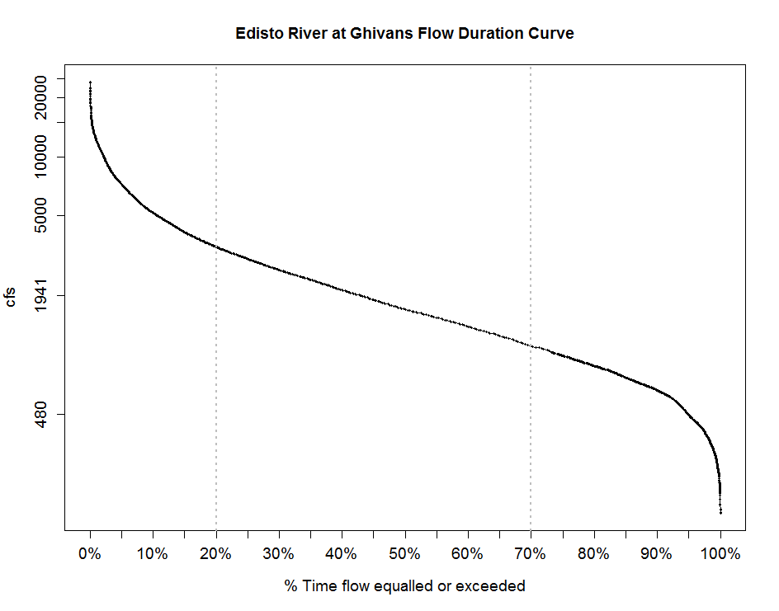

Slide 8
80% mean = regulatory safe yield

Slide 9
80% mean = regulatory safe yield
20% mean = minimum instream flow

Slide 10
Charleston CPW is permitted to withdraw 440 cfs. (typical withdrawal is much less)
Current total permitted volume is 750 cfs (not all consumptive)
Source: DHEC
80% mean = regulatory safe yield
20% mean = minimum instream flow

Slide 11
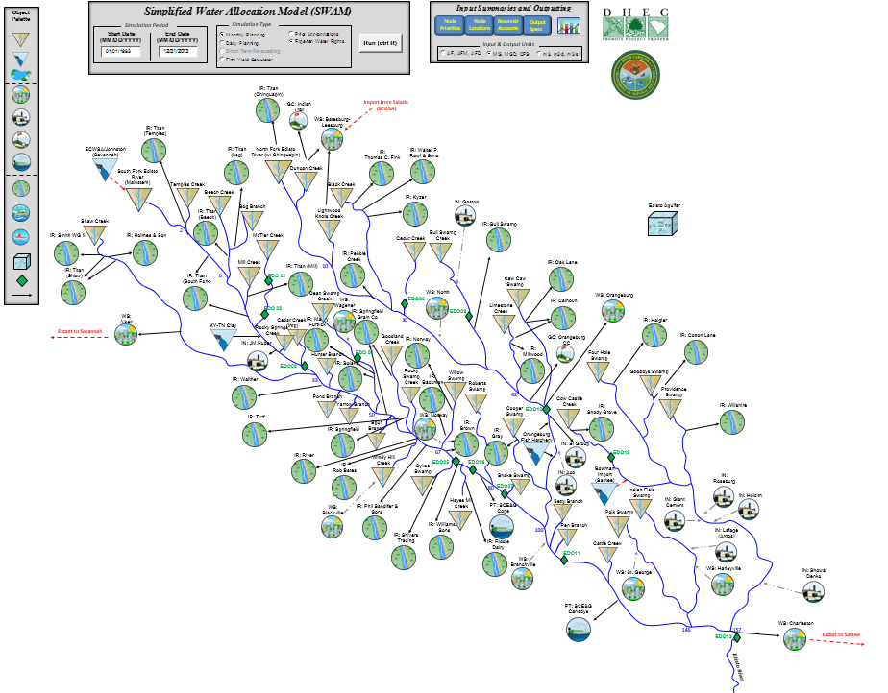

Slide 12
Edisto SWAM
Baseline model has not yet been provided.
We have identified issues in the calibration model.
It is a tool in the toolbox. It consolidates information, and indicates where more data is needed.
A single, simplified model capable of representing watersheds across the state.
Based on these results, we believe further investigation is needed in this basin – for water planning and determination of safe yield.
It’s a long term issue. We are trying to build a foundation of sound science.

Slide 13
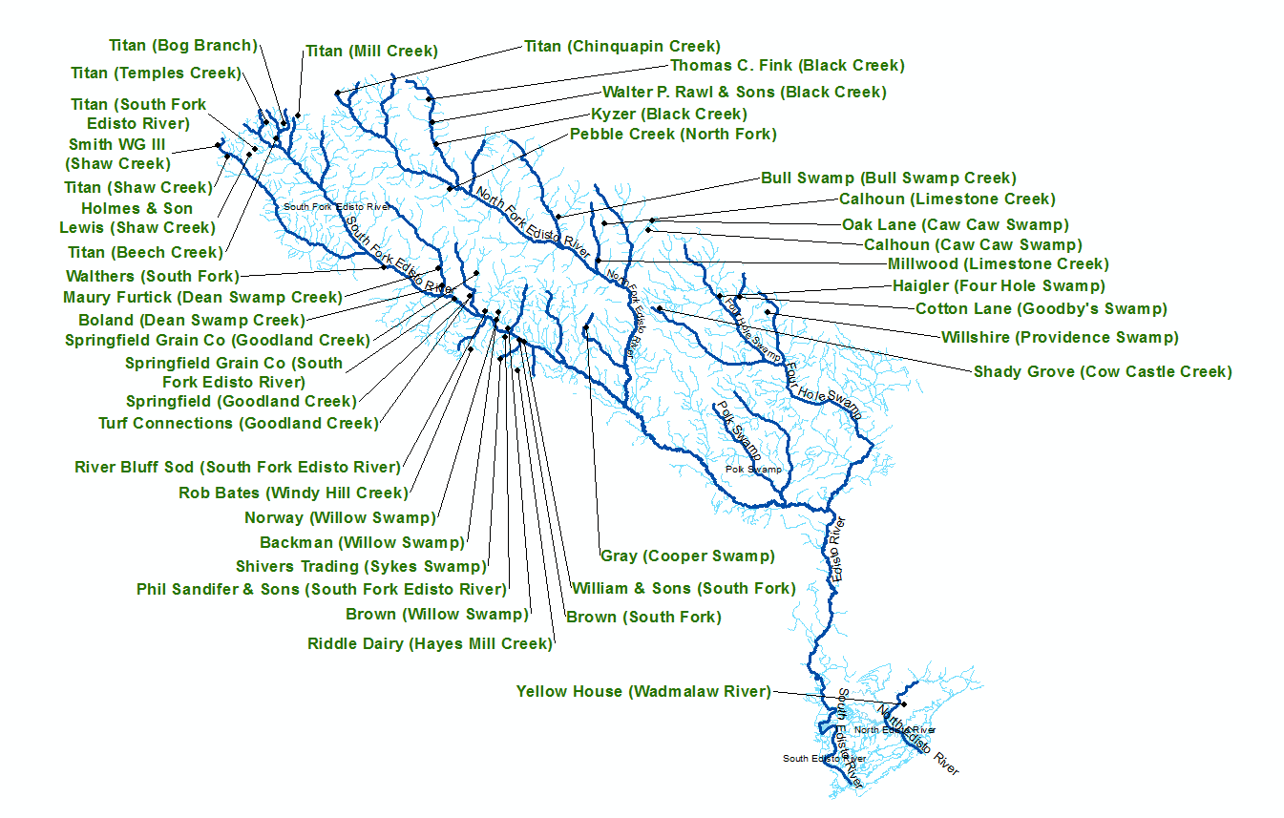
Dark blue streams are included in SWAM, light blue streams are not.

Slide 14

Schematic of USGS gages in the Edisto Basin.
Period of Record is displayed graphically beneath the gage info.
EDO1
McTier Creek
nr Monetta 02172300
10,000 ac
16 sqmi
EDO4
Dean Swamp Creek nr Salley 02172640
19,900 ac
31 sqmi
EDO2
McTier Creek
nr New Holland 02172305
22,300 ac
35 sqmi
EDO3
S. Fork Edisto
nr Montmorenci 02172500
125,300 ac
196 sqmi
EDO8
Cedar Creek
nr Thor 02173212
27,900 ac
44 sqmi
EDO9
Bull Swamp Crk. below Swansea
02173351
21,700 ac
34 sqmi
EDO5
S. Fork Edisto
nr Denmark 02173000
469,100 ac
733 sqmi
EDO10
N. Fork Edisto
at Orangeburg 02173500
438,800 ac
686 sqmi
EDO12
Cow Castle Crk. nr Bowman 02174250
15,500 ac
24 sqmi
EDO6
S. Fork Edisto
nr Cope
02173030
490,000 ac
766 sqmi
EDO7
S. Fork Edisto
nr Bamberg
02173051
520,400 ac
813 sqmi
EDO11
Edisto
nr Branchville 02174000
1,106,000 ac
1,728 sqmi
EDO13
Edisto
nr Givhans 02175000
1,737,300 ac
2,715 sqmi

Slide 15
Area Proration
SWAM approximates the area proration model of streamflow.
On average, over time, the area proration model works well.
Limitations: flow routing, variable baseflow, only applies in similar areas . . .

Slide 16
Convo w Chris Thomason
Hardwood cutting has increased when the computer industry took off. Computer paper is a mix of pine and hardwood. Most of the floodplain forests have been clearcut in the last 30 years.
Planted pine has exacerbated drought flows. First few years, planted pines don’t cause much issue, but when they are 15-20 years old in a monoculture, they take up a lot of water. They found that streams in those areas would dry up faster than flows in other areas. USGS or other?
Last 15-20 years, the beavers came back. Huge amounts of those. May help during low flows. If you go back 25 years, there wouldn’t have been any.

Slide 17
Where to from here?

Slide 18
Further investigation . . .
Rainfall-runoff model
Integrated Groundwater-Surface water model
More advanced statistical techniques
Nonlinear Autoregressive Moving Average with Exogenous Inputs
User friendly web applications to communicate

Slide 19
Basin planning councils
Open forum
Coalition of the willing
No one is excluded
Be creative, how can you help?

